Slide 1

OneSupport Help Center (OSHC) Training
Notes:
Welcome to the one support help center training.

Slide 2
Content Covered
In this training you will learn how to…
Navigate through the OneSupport Help Center
Follow a section
Submit a Request
View Activities
AARP Foundation Tax-Aide
Notes:
In this one support help center training we will cover how to navigate through the one support help center. We Will also look at how to follow a section which will be very important with all the new volunteer portal articles that are currently being loaded daily. There will be many New and updated articles housed under the operational procedures and volunteer portal section. Therefore following the sections under operational procedures and volunteer portal will provide users with real-time email communications when a New article is added or updated. We will also cover how to submit a request which will allow tickets to be routed to the correct expert group and last but not least we will view activities and how users can keep up with tickets that was submitted by them or that they were copied on.

Slide 3
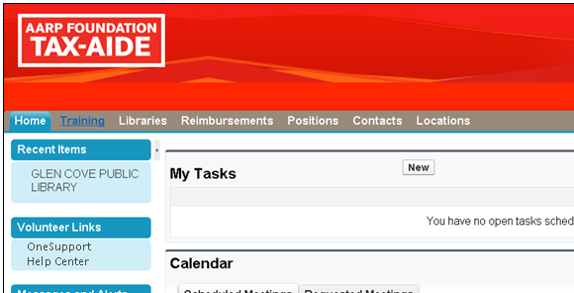
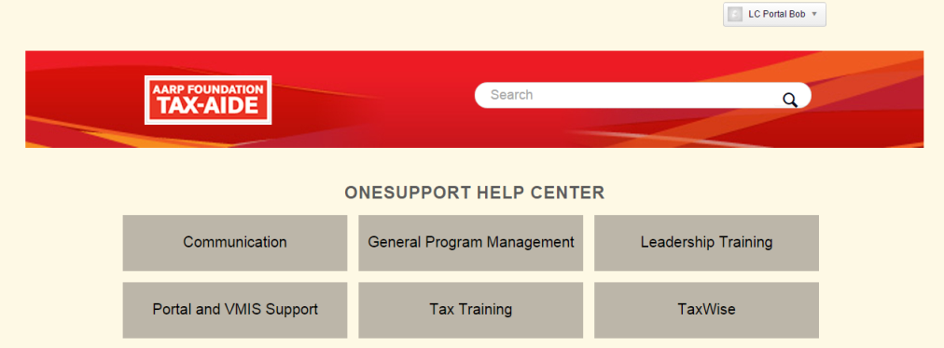

OSHC Overview
To access the OneSupport Help Center, navigate to www.volunteers.aarp.org.
AARP Foundation Tax-Aide
Notes:
The help center is a volunteer support structure that seeks to provide timely support to text aid volunteers. Once logged in to the new Volunteer Portal select the home tab and click on the arrow pointing to the right. Next scroll down and look for the section called Volunteers link and click on the OneSupport Help Center.

Slide 4
DEMO: how to navigate through the help center
AARP Foundation Tax-Aide
Notes:
Click on OneSupport Help Center under Volunteer Link on Volunteer Portal Home Page.
OneSupport Help Center Home Page will open in a separate window
3) Search Options
Use Keyword Search
Select Category
Click one of top three article OR
Click on heading to view list of articles
*Number in () indicates the total number of articles
4) Navigating within the Help Center
5) View Article
A. Click the path to navigate between categories
B. Click the file name to download the article
C. View the message
D. Click the link or file name to view the attached article
E. Click on link to download a Zip OR Click on individual files included in zip file
F. Click on Thumbnail to view slide image

Slide 5
DEMO: how to Follow a Section
AARP Foundation Tax-Aide
Notes:
ABOUT
“Follow” provides real time email notification when a new article is created or updated within a specific section (subcategory).
You may choose to follow as many sections (subcategories) as you choose.
As the content owner, if you are following the section (subcategory) you are updating, you will not be notified via e-mail
Navigate to a section (subcategory) of interest.
2. Click on the ‘Follow’ button next to the section (subcategory) and select “New Articles”.
NOTE: When a new article is created or updated, an email notification is sent to the email address you used to login into the Portal.
***The comment option is not available at this time, so please do not select “New Article And Comments.”
3. If you no longer want to follow a section, click the unfollow box or navigate to my activities, select the follow option and unfollow the section by clicking on unfollow.

Slide 6
DEMO: how to submit a request
AARP Foundation Tax-Aide
Notes:
About
Submit a Request allows volunteers to send any program related inquiry for assistance via OSHC. These requests are automatically triaged to the right group for faster response based on the category of the request.
Categories
Operations – Staff support
Volunteer Portal – All volunteer Portal inquires
Sites – All site request
Tax Training – Tax Law and Training inquires
Technology – Hardware and Software inquires
Note: Most categories have subtopics that helps defines the type of an inquiry
Click on OneSupport Help Center under Volunteer Link on Volunteer Portal Home Page.
OSHC Home Page will open in a separate window. Click on Submit a Request at the top
Select a category for your inquiry by clicking on the drop-down arrow
Type in the subject that describes your inquiry.
Based on the entry in the Subject field, OneSupport will automatically show a list of articles. Clicking on a suggested article will open that article for review.
If the article did not answer your question, hit the back navigation to proceed with providing details in Description box.
Select a subtopic by clicking list box.
Optional: Attach file if you have one to go with the request.
Optional: Add a screencast of the issue.
Click on Submit.
11) Upon submit, you will be directed to “My Activities” view where you will see a confirmation window near the top and your ticket new ID number under My request.
12) You will also receive the following standard communication via e-mail shortly after submitting a ticket. An expert will get back to you within 24 hours.

Slide 7
DEMO: how to view activities
AARP Foundation Tax-Aide
Notes:
About
My Activities provides volunteers a view of all requested tickets with the ticket status and an option to update the ticket if necessary. There is also an option to review all sections being followed with an option to unfollow a section.
Click on OneSupport Help Center under Volunteer Link on Volunteer Portal Home Page.
OSHC Home Page will open in a separate window. Click on My activities at the top
3) My Activities
Request
Contributions once turned on (the feature is currently turned off) will allow you see a listing of all comments made on a particular article. More information to come once this feature is turned on. If you click on the link, you will see a message stating that “You have not asked any questions yet.”
Following: This feature provides real time email notification when a new article is created or updated within a specific section (subcategory). You may choose to follow as many sections (subcategories) as you choose.
Example: If you are not receiving the CyberTax communication, by following the CyberTax section ensure you receive an e-mail notification every time a new CyberTax communication is posted to OneSupport Help Center.
Note: For more information on how to follow an article. See How To Follow A Section (Subcategory) REV 112014. OSHC > Operational Procedure and Volunteer Portal> Help Desk Support

