Slide 1

Material Ordering Training
Chapter 9
Notes:
Welcome to the new volunteer portal material ordering training

Slide 2
Content covered
In this training you will learn how to…
Place an order
Order on behalf of a volunteer
Check the availability of an item
Check an order status
Copy an order
Save an order
Create favorites
AARP Foundation Tax-Aide
Notes:
In this training you will learn how to place an order, order on behalf of a volunteer, and check the availability of an item. This training will also cover how to save an order, copy an order, check an order status, and last but not least how to create favorites.

Slide 3
What’s new?
Ability to check status of items/materials ordered
Images are shown with item description
Volunteer’s address populates when placing an order on behalf of said volunteer
Ability to check the availability of an item before placing an order
AARP Foundation Tax-Aide
Notes:
What's new with Material ordering? It will allow our volunteers the ability to check status of items and/or materials of orders. Images are shown with each item description now. Volunteers address will populate when placing an order on behalf of said volunteer. We also now have the ability to check The availability of an item before placing an order.

Slide 4
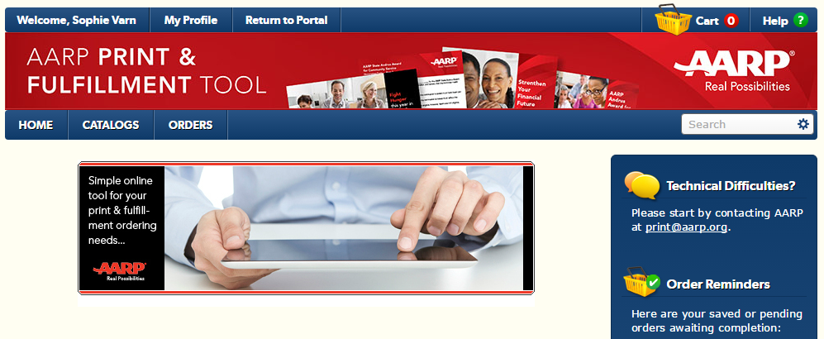
Homepage
AARP Foundation Tax-Aide
Notes:
We will now start by looking at the material ordering homepage starting with my profile:
The my profile tab displays the users address book, personal settings and preferences.
The return to Portal tab logs a user out of the orders view and redirect them back to the Volunteer Portals orders tab.
The home tab will take the user back to the order homepage where they will see Tax-Aide specific messages as well as a list of items that the user marked as favorites.
The catalogs tab displays the material catalog and handbook. You also have the option to select to view items by their category or all items.
The orders tab allows users to search for orders, view saved orders, copy a recent order, and quickly add multiple known items using the quick item entry option.
The cart button located near the top right will take users to their shopping cart and next to the cart image is the total number of items currently in the cart.
The help button give additional information on the page that the user is viewing as well as applications requirements.
The search text field allows users to do a global search for items and/or materials.

Slide 5
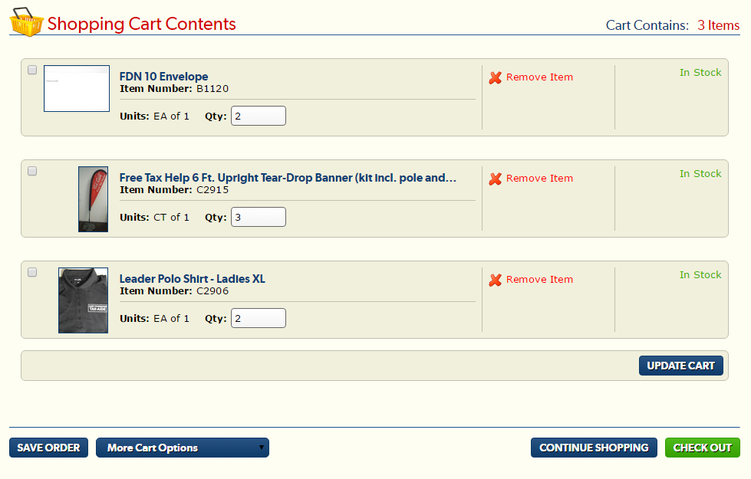
Shopping Cart
AARP Foundation Tax-Aide
Notes:
Now we will view the shopping cart starting with the quantity field which allows users to change quantities of items ordered. Users must click the update cart button if quantities are changed:
The red X and remove item link allows users to remove items from the shopping cart.
The availability of items are displayed on the right-hand side in green letters with the status of the item being ordered.
Near the bottom left you will find the save order button which allows users to keep the content of their cart and return to it at a later date. If an order is saved the users will be prompted to enter a name to save the order as. Making it easier to find the saved order at a later date.
Next to save orders you will see the More cart drop-down window option which gives users the option to either remove the selected items from the cart or save them as a new order.
Near the bottom next to check out You will see the continue shopping button which brings users back to the catalog allowing the user to continue adding items to their cart.
When a user finish editing the shopping cart the checkout button will take he/she to the delivery options page.
I will now hand this presentation over to Sophie who will demo how to order materials, order on behalf of the volunteer, and how to check an order status.

Slide 6
DEMO: Ordering Materials
AARP Foundation Tax-Aide

Slide 7
DEMO: Ordering materials
APPLICABLE ROLES: RC, SMT member, DC, AC, LC
SCENARIO:
All users with Volunteer Leader Edit and Read Only profile can order material for themselves. In this demo, we will go over the steps how to select and order AARP materials on easy to use system.

Slide 8
Ordering Materials
STEPS:
From the homepage, click the orders tab.
Click the orders link
On the AARP Print & Fulfillment Tool homepage, select how many items you would like to view at one time from the “show” menu (recommended 64)
Select the items you would like to order. There are two ways you can place an order: hovering over the item or clicking on the item. Hovering over the item opens a popup window for you to type in the desired quantity. You can also check the availability of the item from the hover view. Note: An item can be marked as favorite from the hover view and from the window that appears when you click on the item.
When you are ready to check out, click the cart button in the upper right hand of the page to take you to your shopping cart or you can select view cart once the last order has been added to the cart.
Make updates to your cart and click check out or you can choose to save the order for a later day or time.
Select your address or manually enter an address by selecting "manually enter address" from the dropdown window. If you have a seasonal address in your contact record, that address will populate as a potential address for you to use as well.
Click next.
Enter the three required fields if not already populated: Name, Phone Number, and Email Address.
Click submit order .You may print the order confirmation page

Slide 9
DEMO: Ordering on behalf of a volunteer
AARP Foundation Tax-Aide

Slide 10
DEMO: Ordering on behalf of a volunteer
APPLICABLE ROLES: RC, SC, ADS, PVS, DC, AC
SCENARIO:
All users with Volunteer Leader Edit profile can order material for behalf of others. In this demo, we will go over the steps how to select a volunteer and order AARP materials on behalf.

Slide 11
DEMO: Ordering on behalf of a volunteer
STEPS:
From the homepage, click the orders tab
Click the order on behalf of a volunteer link
Click on the look up icon (magnifying glass) next to the Select Requestor field
Type in the user’s name and click go
Click the name of the volunteer for whom you are placing the order
Once back in the order on behalf of view, click submit. If you receive an error message it is because the volunteer does not have a up to date contact record therefore they will need to update their address, email address, and contact number
Once on the AARP print and fulfillment window, opens in a new browser select the items that you would like to order on behalf of the volunteer
Proceed to your cart to checkout.
Make updates to your cart and click check out or you can choose to save your order for a later day or time.
The address of the person who you are ordering on behalf of will be displayed in the address field. You still have the option to manually enter an address
Click next.
Enter the three required fields if not already populated: Name, Phone Number, and Email Address.
Click submit order
Print the order confirmation page
You will receive the sales reference number and an email confirmation will be sent to the person for whom you are placing the order

Slide 12
DEMo: order Status
AARP Foundation Tax-Aide

Slide 13
DEMO: Order Status
APPLICABLE ROLES: RC, SMT member, DC, AC, LC
SCENARIO:
All users with Volunteer Leader Edit and Read Only profile can check pending and complete order statuses for themselves. Those who placed order on behalf can also check status for the order recipient. In this demo, we will go through the steps to check pending order status.

Slide 14
DEMO: Order Status
STEPS:
From the homepage, click the orders tab
Click the order status link
Search for your order using the sales reference number, the order status, or the requestor's volunteer ID. You have the option of selecting your date range-not to exceed 90 days. All of your most recent orders will populate below before a search is done.
Select the scope field
Click search

Slide 15
DEMO: Copy and save order for future use
AARP Foundation Tax-Aide

Slide 16
DEMO: Tips and Tricks
APPLICABLE ROLES: RC, SMT member, DC, AC, LC
SCENARIO:
System offers additional helpful features. In this demo, we will go through the steps to Copy and Save order for the future use.

Slide 17
DEMO: Tips and Tricks
STEPS:
Copy Order:
1. Click the copy this order button on the Order confirmation page upon checking out.
To copy a previous order, go to the AARP Print & Fulfillment Tool catalog page
2. Hover your cursor over the orders tab, and from the dropdown window that appears, click "copy recent orders"
3. Click the reference number of the order that you would like to copy.
4. In the order line details, verify that this is the order you would like to copy.
5. Click "back to copy recent orders" to return to the previous page.
6. Click the shopping cart next to the order you would like to copy to bring you to the shopping cart of this order.
Save Order:
1.Once in your shopping cart, click save order.
2. Enter your order name, and click save.
3. To view a saved order, go to the AARP Print & Fulfillment Tool homepage.
4. Hover your cursor over the orders tab, and from the dropdown window that appears, click "saved orders"
5. Click on the basket next to the saved order you wish to see to be brought to the shopping cart of the saved order.

