Slide 1
Introduction to the Portal Training
Chapter 2
Notes:
The new Volunteer Portal is used by every AARP volunteer to record and report information as required by their job responsibilities.
The new Volunteer Portal is continuously evolving as requirements emerge and new functionality is added.

Slide 2
Contents Covered
Today you will learn…
About technology requirements for the Portal
How to log out
About the homepage
About field types in the new Volunteer Portal
Notes:
The new Volunteer Portal interface has many different means to access information. Access is defined by the assigned level, based on the role of the individual. All ADSs and DCs have the same access. This means that individuals must be aware of the task they are authorized to perform. Our motto is “Just because you can, doesn’t mean you should!”
We will review all the navigation tools you need for the new Volunteer Portal.

Slide 3
Technology Requirement
The following browsers are supported in the new Volunteer Portal. No other, lower level, browsers are supported.
Chrome (recommended)
IE Version 11 or higher
Firefox
Safari
Pop-Up Blockers must be turned OFF
Tax-Aide is not supporting Tablet users at this time
Notes:
Chrome is the recommended browser for the new Volunteer Portal. Other browsers are supported, including Safari for Apple products.
Many functions will not work properly without pop-ups. Consult your browser help function or assistance with pop-up blockers can be found on the internet. Search using the terms ‘How to turn off pop-up blockers in _______________’, inserting the name of your browser.

Slide 4
Login Portal Account
This process is still in development and an announcement, with specific process steps, will be made when the procedure is available.
Notes:
When we are live in production mode, we will update the login procedures. Every volunteer will need a unique email address for login.

Slide 5
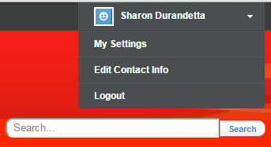
Log Out of the Portal
DO NOT USE
Use only these two items.
Notes:
To logout, click on your name in the upper left of the screen (Number 1). The picklist shown above will appear. Click on Logout (Number 2). It’s very simple, really.
Do not use either of the other two choices. Use of My Settings and Edit Contact Info are not supported by Tax-Aide

Slide 6
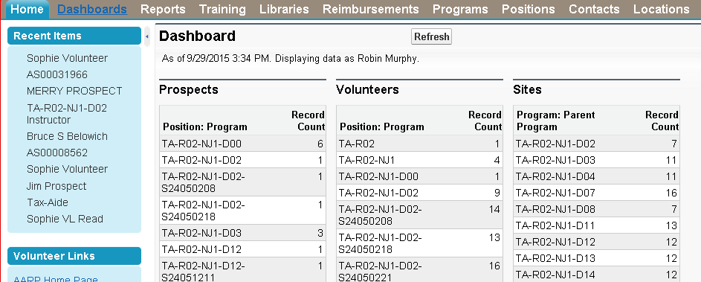
Homepage : Volunteer Leader
Notes:
Let’s review the components of the Portal. This screen is for a volunteer with Volunteer Leader Edit access. ADSs and DCs, among others, have this level of access. The available records are not limited to Tax-Aide. Anyone with Leader or Staff access can see records for all AARP programs. Volunteer Leader Edit or Staff access allows the individual to edit nearly any records in the database, in all AARP programs.
There are tabs across the top of the display screen. We will review how each of these is utilized by Tax-Aide. Explanations of the content on each screen are explained in detail in other presentations.
The first is the Home screen. Once you choose a Dashboard, it will display automatically on the Home tab.

Slide 7
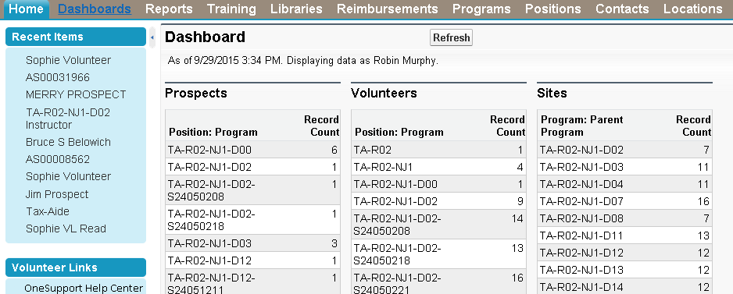
Sidebar
Notes:
Additional information can be found in the Sidebar by clicking on the small arrow (s) on the left side of the screen. A link to OneSupport will be under Volunteer Links starting October 12.

Slide 8
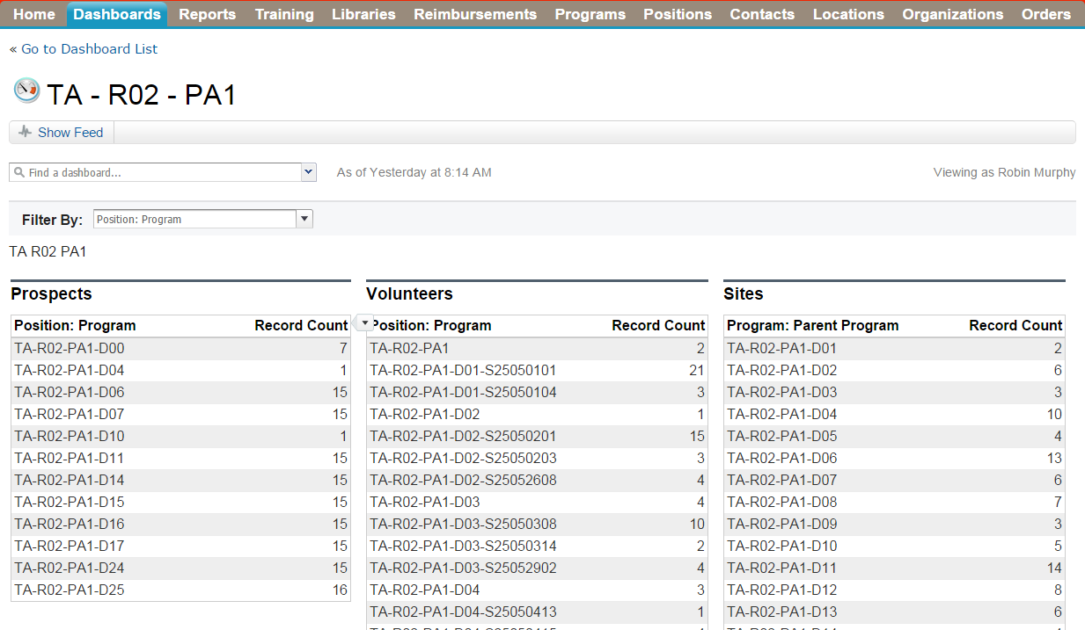
Dashboard : Volunteer Leader
Notes:
Dashboards brings you to a page where you can access and run dashboards, which are tables that summarize report data.
The Dashboard tab opens with the details of the Dashboard you previously selected. If you wish to change the Dashboard, choose your dashboard in the ‘Find a Dashboard’ drop-down menu. The details of Dashboards are explained in another session.
This demonstrates another feature of the new Volunteer Portal. There is frequently more than one way to get to the desired place in the system. Choosing your dashboard in the ‘Find a Dashboard’ drop-down menu brings you to the following screen.

Slide 9
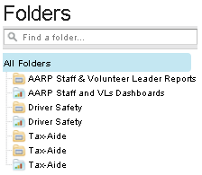
Reports : Volunteer Leader
Notes:
Clicking the Reports tab brings you to a page where you can view, run, export, and print reports. Reports return a set of records that meet specified criteria and organizes them into rows and columns, reflecting the system’s current data.
On the Reports tab, you will find two sections. Various reports are stored in the folders. Once a folder is selected, the contents are displayed in the other section of the screen.
Many displays have filters on the page, operated by picklists. This page has two. The first has four choices and the second three.

Slide 10
Unused Tabs : Volunteer Leader
Notes:
The next three tabs, Training, Libraries and Reimbursements-including Organizations- are not utilized by Tax-Aide.

Slide 11
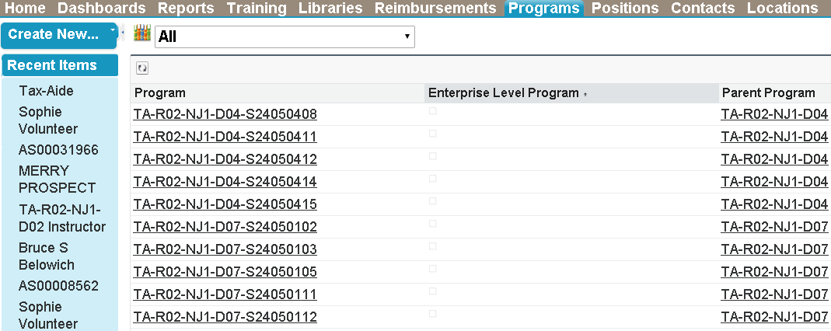
Programs: Volunteer Leader
Notes:
The Programs tab is used to quickly access all program records in the database.
Clicking on ‘Go’ next to the View box, with ‘All’ in the field, will generate a list of all program records. Remember, all program records across all AARP programs.
The list is arranged alphabetically, by default. Clicking on a letter will display program records beginning with the letter selected. This is the list of programs beginning with ‘T’. All Tax-Aide program records begin with ‘TA-’.

Slide 12
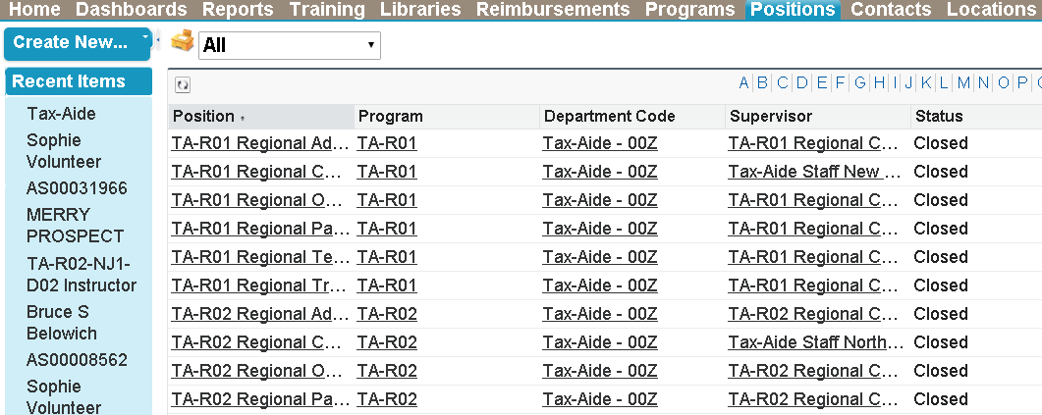
Positions: Volunteer Leader
Notes:
The Positions tab works the same as the Programs tab, and is used to quickly access all positions in the database.
Clicking on ‘Go’ next to the View box, with ‘Open Positions’ in the field, will generate a list of all open positions. Remember, across all AARP programs.
This list is also arranged alphabetically, by default. Clicking on a letter will display records beginning with the letter selected, just as on the program tab. Alternatively, you can jump ahead in the list by choosing a page number.
This shows count of the displayed records. Clicking on this arrow will open a window where you can select the number of records displayed at once.

Slide 13
Contacts: Volunteer Leader
Notes:
The Contacts tab will display a list of volunteers, and allow you to search for Volunteer Contact Records. The Contacts tab also works the same as the Programs tab.
This image is of ‘Recently Viewed Contacts’. This view is useful when you need to get in and out of records, or return to a record. Note the same features as the previous tabs: number of records displayed, page selection and alphabetical list selection.
Clicking on ‘Go’ next to the View box, with ‘Open Positions’ in the field, will generate a list of all open positions. Remember, across all AARP programs.
This list is also arranged alphabetically, by default. Clicking on a letter will display records beginning with the letter selected, just as on the program tab. Alternatively, you can jump ahead in the list by choosing a page number.
This shows count of the displayed records. Clicking on this arrow will open a window where you can select the number of records displayed at once.

Slide 14
Locations: Volunteer Leader
Notes:
The Locations tab also works the same as the other tabs.
The records can be sorted by clicking on the column heading, such as the Record ID or Location name.
Note the ‘Edit’ option next to the record. You will see this throughout the Portal. Clicking on ‘Edit’ frequently accesses different records or views than clicking on the record itself.

Slide 15
Orders: Volunteer Leader
Notes:
The Orders tab provides the option to place an order, check order status, or order on behalf of a volunteer. All three options will lead to the AARP Print & Fulfillment Tool webpage, which opens in a new window.

Slide 16
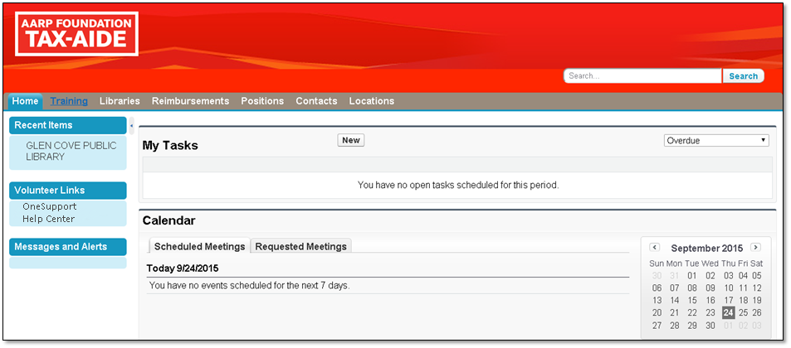
Homepage : Volunteer
Notes:
A Volunteer will have a different, more limited view than a Leader. Navigation works the same, however.
A link to OneSupport will be under Volunteer Links starting October 12.

Slide 17
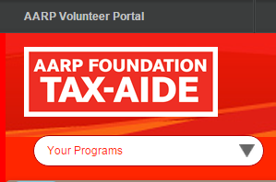
Program Selection : Volunteer
Notes:
Many Tax-Aide volunteers also volunteer in other AARP programs. These volunteers can choose their records for the program they wish to edit. This field impacts personal information.

Slide 18
Required Fields
Notes:
Now, let’s take a look at the different fields in the Portal. Information in the Portal is entered in fields. The relationship between fields is explained in other sessions. In this example, the Last Name can be changed by typing the new name in the box.
Note that any field with a red line on the left is a Required Field. In this record, the Last Name is required. All other fields are optional.

Slide 19
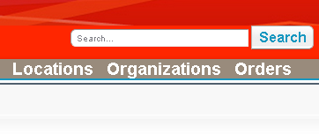
Global Search
Notes:
The Global Search field provides a means to quickly access desired records. Wildcards, such as *, ?, and, or, etc. can be used to broaden the search results.

Slide 20
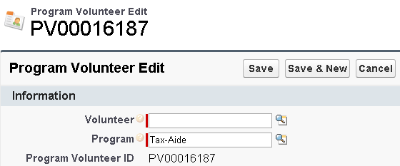
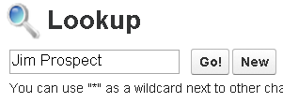
Lookup
To enter data into the Lookup field:
Click the Lookup icon (magnifying glass) next to the field
Enter the appropriate data into the Search box
Click Go
Notes:
Many fields have a specific lookup function available. Click on the magnifying glass next to the desired field. A search box will open. Type the appropriate data into the Search box, using wildcards if desired.

Slide 21
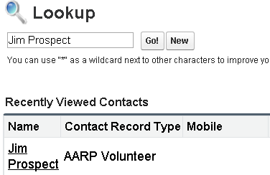
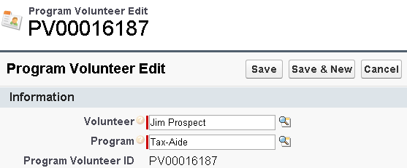
Lookup (Cont’d)
From the Search Results, click the option that matches the data desired
The data you selected is now entered into the field
Click Save
Notes:
Choose the desired record from the search results. The selected record will populate the original field.

Slide 22
Multi-Select Picklist
Multi-select picklists contain several items. Some or all can be chosen to include in a record
To select an item, move it from the Available field to the Chosen field using the right arrow
To remove an item, move it from the Chosen field to the Available field using the left arrow
Notes:
A multi-select picklist contains several items. Some or all of the items can be selected to be included in the record. Move the items on and off the desired list using the arrows in the center of the two frames.
Note: Select multiple items to move at one time by holding down the Ctrl key on your keyboard.

Slide 23
Multi-Select Picklist (Cont’d)
Click Save
The item you selected is now associated to the record
Notes:
Saving the record is critical. Navigating away from a record before hitting save results in loss of data.

Slide 24
Picklist
Click the arrow in a Picklist field to select an item
Click an item to select it
Click Save
Notes:
A picklist is also commonly known as a dropdown list or box. These are used to fill a field with one item only.

Slide 25
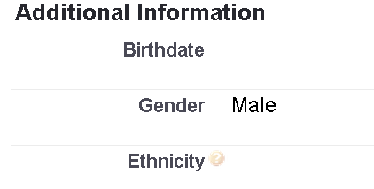
Picklist (Cont’d)
The item you selected is now associated to the record
Notes:
Picklists are widely used in the new Volunteer Portal.

Slide 26
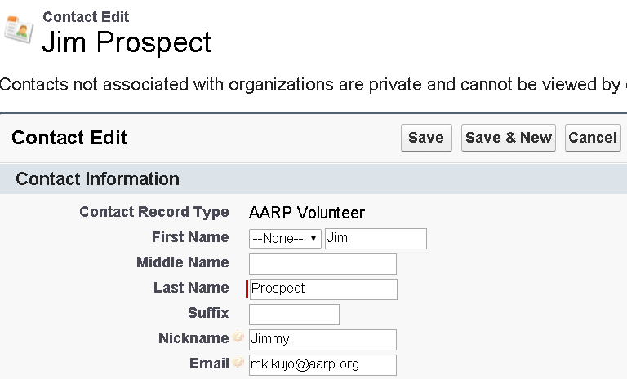
Text Box
Enter data in a Text field
Click Save
Notes:
Fields without a picklist, or multi-select picklist, are text boxes. Type the desired data into the field.

Slide 27
Help by Hover
Hover over the question mark
Text box will appear
Notes:
Hover your mouse over one of the orange question marks for more information about a field. Be aware that the displayed help description is generic and does not necessarily apply to the Tax-Aide use of the field. Please consult the appropriate chapter of this manual for Tax-Aide specific instructions.

Slide 28
Demo
Log Off
Tabs
Sidebar
Global Search
Required Fields
Field Types
Look Up
Multi Select Pick List
Pick List
Text Box
Hover

