Slide 1

DC Volunteer Management Training
Chapter 5

Slide 2
Content Covered
In this training you will learn how to…
How volunteer information is structured within the New Volunteer Portal
Roles for volunteer management and when to contact ADS
Update volunteer contact information
AARP Foundation Tax-Aide
Notes:
This presentation will provide guidance for managing information about current Tax-Aide volunteers. It includes a description of the way volunteer assignments are structured within the Tax-Aide organization.

Slide 3
What’s New?
Assignments:
Assignment includes respective program level (e.g. TA-R05-OH2-D01 District Coordinator)
Volunteer leaders can hold more than one assignment under the same role
  i.e. a volunteer who is a LC for two sites will have two LC assignments
For the 2015-2016 season, non-leaders will have only one assignment regardless of how many sites they work at
AARP Foundation Tax-Aide
Notes:
A number of new concepts have been introduced with the advent of new Volunteer Portal.
Each Tax-Aide Assignment describes the role of a volunteer and the location where the volunteer performs that role. In the Assignment example shown here, the volunteer is the District Coordinator for District 1 in Ohio-2, which is in Region 5 (the Great Lakes region).
Volunteers with multiple assignments will occupy multiple positions in the organization. For example, a District Coordinator can also be a Local Coordinator and a Counselor.
An exception, for the current season, is that non-leaders will have only one site-level assignment, even though they work at multiple sites. A Counselor who regularly volunteers at two different sites will have only one Counselor assignment – at their primary site. This is very similar to past years, where a Counselor had only one supervisor even though they worked at multiple sites.

Slide 4
What’s New? (Cont’d)
Supervisor:
Pre-determined by the assigned position
No need to move subordinates when volunteer in supervisory position changes
Data Update:
Volunteers can modify their own personal data
AARP Foundation Tax-Aide
Notes:
The pre-defined organization structure means that supervisor positions are also pre-defined. Every position reports to predefined supervisory positions instead of volunteers reporting to specific individuals. This means that there is no need to reassign supervisors to volunteers when supervisors change assignments.
In the new system, for example, Counselors report to the Local Coordinator position, not to Mary Smith. This is an important distinction, because when Mary Smith is replaced by Jerry Jones, the Counselors continue to report to the Local Coordinator position with no further changes required.
All volunteers are encouraged to update their own personal data in the Volunteer Portal.

Slide 5
Roles for Volunteer Management
 | ADS | DC
Update volunteer contact information | X | X
Add a volunteer job assignment | X | Contact your ADS for these functions
Ending a volunteer job assignment | X
Transfer a volunteer to a different district or split-state | X
Update a deceased volunteer’s record | X | X
AARP Foundation Tax-Aide
Notes:
The ADS and the DC also have access to update volunteer personal data in the Volunteer Portal. Note that the DC may optionally delegate this responsibility to an Administration Coordinator.
A number of tasks are best handled by the ADS. These tasks include:
Adding a new assignment for a current volunteer
Ending a Volunteer’s job assignment
Transferring a volunteer to a different district or a different split state
Either the ADS or the DC can make the necessary changes to record the death of a volunteer

Slide 6
Information Structure
Program - Geographical location
(example: TA-R01-CT1-D01-S10053138)
Role - Job Title
(example: Counselor)
Position - a specific opening on the organization chart
(example: TA-R01-CT1-D01-S10053138 Counselor)
Program Volunteer - (example: Tax-Aide)
Contact - Volunteer
(example: Jane Smith)
Addresses – Volunteer mailing, residence, seasonal addresses
Assignment - a specific volunteer filling a specific opening
(example: TA-R01-CT1-D01-S10053138 Counselor Jane Smith)
AARP Foundation Tax-Aide
Notes:
A number of components are used to contain the information about volunteers This chart shows the relationships that exist between these components:
Program: Describes the Tax-Aide organization in terms of Region, Split-state, District and Site.
Role: Defines a Tax-Aide job title.
Position: A combination of the Program and Role that defines a Tax-Aide job within a specific site or area of responsibility.
Program Volunteer: Defines the AARP volunteer program with which the volunteer is associated, i.e. Tax-Aide.
Contact: Describes a Tax-Aide Volunteer, including the information entered when a Prospective Volunteer registers at www.aarp.org.
Addresses: Lists a Volunteer’s addresses – mailing address, residential address, seasonal address.
Assignment: Describes a specific volunteer filling a position, i.e. Jane Smith assigned as a Counselor to Connecticut 1 District 01 Site S10053138.
Programs, Roles, and Positions are pre-defined and created by the Tax-Aide National Office.

Slide 7
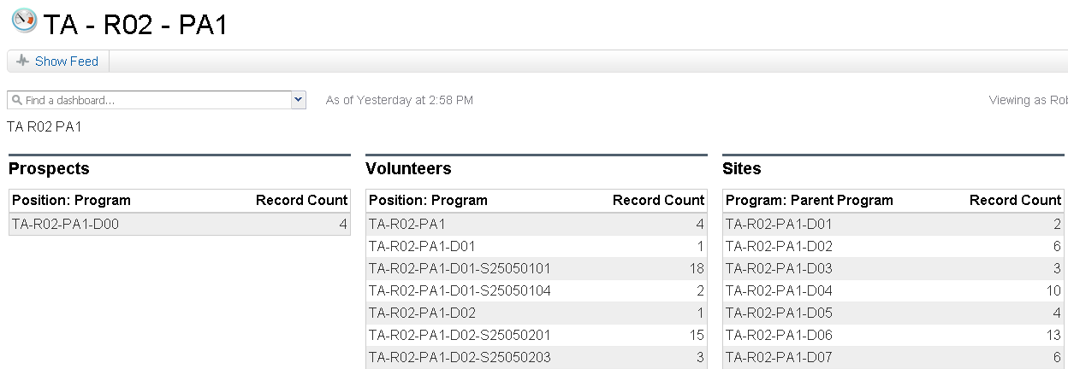
Dashboards
The Volunteers column shows a preview of the Volunteers Report. To access the Volunteers Report, click any line in the Volunteers preview.
Dashboards populate prospective Tax-Aide Volunteers.
AARP Foundation Tax-Aide
Notes:
Volunteer information can be accessed from the Dashboard. The center column of this Dashboard displays a preview of the volunteer data. Clicking on the Volunteers column will create a Volunteers report for the selected split-state.

Slide 8
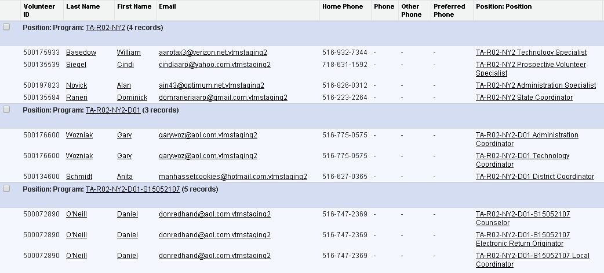
Volunteers Report
The Volunteers Report lists all current volunteers and information from their Contact record.
AARP Foundation Tax-Aide
Notes:
This is a portion of the Volunteers report for New York 2. It is sorted to first show state-level volunteers, then district-level volunteers, then site-level volunteers.

Slide 9
DEMO: Updating Volunteer Contact Information
AARP Foundation Tax-Aide

Slide 10
APPLICABLE ROLES: DC, AC, ADS
SCENARIO:
It is recommended that all personal contact info be updated by the volunteer themselves, however as a DC/AC/ADS you may be asked by the volunteer to update on behalf.
In this demo, we will go through the steps to update an address and phone #.
Note: Email address can only be updated by the volunteer themselves through AARP.ORG. Separate steps will be provided in welcome package.

Slide 11
Updating Volunteer Contact Information
STEPS:
From the portal homepage, enter the volunteer's name or volunteer ID in the search bar, and click search.
Locate the volunteer and click on their name in the Contacts section. Review the volunteer contact info and assignment(s) to make sure this is the volunteer record you wish to edit.
Click the edit button.
Change the phone number, and click save.
To update/change the address, scroll down to the addresses section of the contact record, and click edit.
Change the address, and click save.

Slide 12
DEMO: updating a deceased volunteer’s record
AARP Foundation Tax-Aide

Slide 13
APPLICABLE ROLES: DC/AC/ADS
SCENARIO:
Unfortunately, you received a notification that a volunteer has passed away. In this demo we will go through the steps to properly documented the volunteer's passing on the contact record.

Slide 14
Updating Deceased Volunteer’s Record
STEPS:
From the portal homepage, enter the volunteer's name in the search bar, and click search.
Search for the volunteer's name and click on their name.
Scroll down to the Volunteer Assignment section.
Click Edit.
On the Volunteer Assignment Edit page, end all Tax-Aide assignment. If PV status =Deceased/Under Consideration, change it to Volunteer so that you can and end all assignments.
On Contact page, scroll down to Program Volunteer section.
Click Edit
Change Program Volunteer status = Deceased
Click on Save.

