Slide 1
Credit for Sick Leave and Family Leave
New
Refundable Credits
Self-employed Individuals
Notes:
See Pub 4491 Training Guide What’s New section
In TaxSlayer use Form 7202 to allow self-employed taxpayers to figure these credits.
The two credits are included on Schedule 3 (Form 1040).
Form 7202 is filed separately by each taxpayer with net self-employment earnings.
A joint tax return may have two Forms 7202 attached.
Also see the NTTC Pub 4012 Volunteer Resource Guide, Tab H and www.irs.gov/coronavirus-tax-relief-and-economic-impact-payments

Slide 2
Credit for Sick Leave and Family Leave
New
Families First Coronavirus Response Act (3-18-2020) provided $$$$$ to Employers for Employee Sick and Family Leave payments
This benefit was extended to Self-Employed as the Sick & Family Leave Credit on Form 7202
Need one Form 7202 for each affected SE taxpayer

Slide 3
Credit for Sick Leave and Family Leave
New
Round 1 was originally part of the Families First Coronavirus Response Act (3-18-2020) for 4-1-2020 to 12-31-2020 and this was extended by the Consolidated Appropriations Act (12-21-2020) through 3-31-2021
This applies to TY 2020 and 2021 and is cumulative
Round 2 was a part of the American Rescue Plan Act (3-11-2021) and extended and reset the credit from 4-1-2021 to 9-30-2021 and made other changes to the credit

Slide 4
Credit for Sick Leave and Family Leave
New
Was the business owner unable to work due to COVID?
  Very specific rules to qualify
Self-employed individuals can receive both Credit for Sick Leave and Credit for Family Leave
  Cannot use same days for both credits
These are refundable credits

Slide 5
Sick and Family Leave Credits for Self-Employed
New
For 2021 there are two rounds:
Round 1: 4/1/2020 – 3/31/2021
  10 sick leave days total for TY20 + TY21 ($5,110 max)
  50 family leave days total for TY20 + TY21 ($10,000 max)
Round 2: 4/1/2021 – 9/30/21
  10 additional sick leave days in TY21 ($5,110 max)
  60 additional family leave days in TY21 ($12,000 max)
Notes:
Taxpayer must provide the actual dates (MM/DD) used for sick leave in 2021

Slide 6
Credit for Sick Leave and Family Leave
Worksheets
New
Must use this worksheet to determine eligibility and for documentation:
  2021 Self-Employed COVID Worksheet
    Available on the portal
Taxpayer must bring in prior year’s tax return
  Can elect to use 2020 net earnings from self-employment for 2021 – need to add the additional earnings (2020 - 2021)
  Will need number of days claimed in 2020

Slide 7
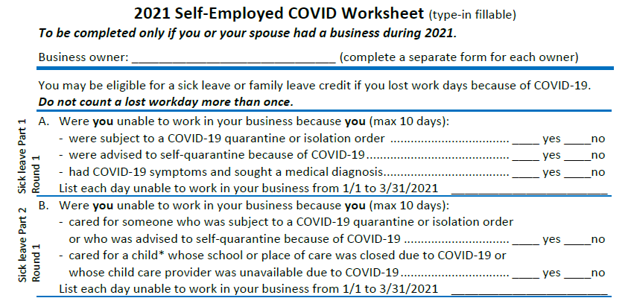
2021 Self-Employed COVID Worksheet Sample
New
Notes:
This is the first part of the 2-page worksheet showing the sick leave reasons for round 1

Slide 8
2021 Self-Employed COVID Worksheet
New
Worksheet has a Part 1 and Part 2 for Sick Leave (10 days)
Worksheet has one section for Family Leave
Worksheet has Round 1 and Round 2 sections
These sections and parts are labeled on the left side of the worksheet
These 6 sections and parts correspond to the 6 entries in TaxSlayer
Notes:
Source: https://www.irs.gov/newsroom/tax-credits-for-paid-leave-under-the-american-rescue-plan-act-of-2021-specific-provisions-related-to-self-employed-individuals #108

Slide 9
Enhanced Sick Leave Reasons – Part 1
New
Round 2 for Sick Leave credit Part 1 is enhanced to cover:
  Leave for a COVID-19 test after exposure (to find and get the test or while waiting for the results/diagnosis)
  Leave due to a COVID-19 vaccination (to obtain immunization related to COVID-19 or to recover from any injury, disability, illness, or condition related to the immunization)
These reasons do not apply to round 1 from 1/1 to 3/31
Notes:
Source: https://www.irs.gov/newsroom/tax-credits-for-paid-leave-under-the-american-rescue-plan-act-of-2021-specific-provisions-related-to-self-employed-individuals #108

Slide 10
Enhanced Sick Leave Reasons – Part 2
New
Round 2 for Sick Leave credit Part 2 ($200/day limit) is enhanced to cover:
  Leave to accompany an individual to obtain immunization related to COVID-19
  Leave to care for an individual who is recovering from any injury, disability, illness, or condition related to the immunization
These reasons do not apply to round 1 from 1/1 to 3/31
Notes:
Source: https://www.irs.gov/newsroom/tax-credits-for-paid-leave-under-the-american-rescue-plan-act-of-2021-specific-provisions-related-to-self-employed-individuals #108

Slide 11
Enhanced Family Leave Reasons
New
Round 2 for Family Leave credit is enhanced to cover:
  All previously allowed sick leave reasons including the enhancements
  But cannot claim both credits for the same day
These reasons do not apply to round 1 from 1/1 to 3/31
Notes:
Family leave for round 1 is limited to caring for a child whose school or place of care was closed or whose child care provider was unavailable due to COVID-19

Slide 12
Sick and Family Leave Credits for Self-Employed
New
Special rules for U.S. possessions
Documentation as per IRS guidelines
  See page 2 of Self-Employed COVID Worksheet
Form 7202 will have 4 Parts to cover both rounds for both the Sick and Family Leave credits
Generally reduced for employer-paid leave wages
Notes:
Certain federal government employees that have a business may not need to reduce the maximum credit limitation for employer-paid leave wages.

Slide 13
Lessons Learned from 2020
Use caution when asking the probing questions to determine the necessary details about the who, what, when, and why. Many individuals are sensitive when it comes to sharing details about the coronavirus for themselves and family.
None of the taxpayers had any knowledge of this credit and did not maintain any documentation. We had to ask probing questions and walk the taxpayer though the Worksheet. Documentation only consisted of notes and dates that we added to the Worksheet.

Slide 14
Lessons Learned from 2020
We did give affected taxpayers a blank copy of the Worksheet and advised them that these credits were extended into 2021 and asked them to keep track of affected days in 2021. It is doubtful that we will see much documentation for 2021 and counselors will again be asking the probing questions to get the Worksheet completed.
We found the 2020 Worksheet to be confusing and difficult to use due to all the duplicate reasons in the different sections. The 2021 Worksheet looks to be even more challenging and it would be unrealistic to expect a taxpayer to complete this on their own.

Slide 15
Lessons Learned from 2020
One approach is to first determine if the SE taxpayer did miss SE workdays due to COVID for self, others or family. Then get the details as who, what, when, and why.
Then see where the affected days fit into the categories on the Worksheet.

Slide 16
Lessons Learned from 2020
Suggest using the following simplified criteria for both Round 1 & 2 as a starting point and then get details:
For Sick leave Part 1: You were unable to work because you were affected by COVID-19
For Sick leave Part 2: You were unable to work because you were caring for and individual affected by COVID-19
For Family leave: You were unable to work because you were providing coronavirus-related care to your child

Slide 17
Lessons Learned from 2020
Then make the corresponding entries in TaxSlayer for both Round 1 & 2:
“I required care for myself”
“I provided care to another”
“I provided care to my son or daughter because their school of place of care was closed”

Slide 18
TaxSlayer Entries
Once the number of affected days are determined, the TaxSlayer entry is fairly simple
Be aware that the verbiage is different between the Worksheet and TaxSlayer entries
Currently Practice Lab does not have a method to enter affected dates and Round 2 Family Leave is being limited to 50 days instead of 60

Slide 19
Training Exercise
Use the Terry Baldwin focused exercise from the 2021 NTTC Workbook

