Slide 1
Economic Impact Payments and Recovery Rebate Credit
Notes:
Economic Impact Payments and claiming the Recovery Rebate Credit taxpayers who didn’t qualify for the 3rd EIP or did not receive the full amount may be eligible for the RRC based on their 2021 tax information.
They’ll need to file 2021 tax return, even if they don’t usually file, to claim the credit.
Taxpayers will also need the amount of their 3rd EIP, and any Plus-Up payments received to calculate their correct 2021 RRC amount.

Slide 2
American Rescue Plan Act of 2021
IRS will send Letter 6475 and/or Notice 1444-C to Taxpayers in early 2022
  Will detail amount of the 3rd EIP payment AND any Plus-Up payments (adjustments due to 2020 vs 2019 differences)
  Information will be available online by accessing their account
  Delays in any refund if amounts not entered accurately
Notes:
The IRS are mailing out the Letter 6475 and/or Notice 1444-C to people who received a 3rd EIP.
Taxpayers should keep this and any other IRS letters about their stimulus payment.
Need to remember to ask to see any letters received from the IRS and then keep with the taxpayer's records.

Slide 3
EIP3 and RRC
IRS draft F1040 instructions clearly ask for EIP received by the taxpayer, and spouse if filing MFJ
  Do not include EIP received by a dependent
  RRC for a properly claimed dependent is ok, even if someone else got EIP for that same dependent
  Taxpayer is entitled to RRC, even if another taxpayer received EIP for them, e.g., they were a dependent of another taxpayer in 2020
If individual is a dependent of another taxpayer, check the box on the personal information page (no RRC allowed)
  Even if another taxpayer does not claim the individual as a dependent
Notes:
Instructions for the draft 1040 Form is asking for EIP received.
We are only putting in the amount the taxpayer the received.
If the dependent received EIP, we are not to worry about it.
Under the IRS rules we are not to worry about double dipping.

Slide 4
EIP3 and RRC
If EIP was based on a joint return (e.g., 2020 or 2019), EIP received by either spouse is split between the two
  Includes EIP received for a dependent
The amount received as EIP is reduced for the amount returned to the IRS
Excess EIP3 does not have to be repaid
If either spouse is military, be sure to mark as such
2021 EIP worksheet is being revised (for taxpayer to complete and use)
Notes:
Just some reminder rules most are in the NTTC Pub 4012.
If a couple received the full about, and are filing MFS, or got a divorce then you would split the total amount. The one calming the child would get the different.
If they returned the EIP then you would enter $0.
If they received more then they are entailed to it does not have to repay.
If military and have a spouse with on SSN this would help them get the full amount. Will need to be military certificated.
The worksheet is being revised. For the taxpayer to fill out.

Slide 5
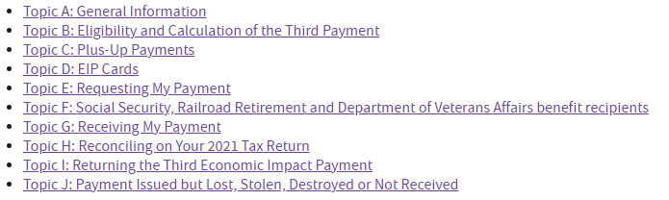
Questions and Answers about the 3rd EIP
Notes:
The 3rd EIP was authorized by the American Rescue Plan Act of 2021 as an advance payment of the 2021 Recovery Rebate Credit. Most eligible people won't need to take additional action to get this payment.
This is the list of the 10 Topics of frequently asked questions about the Third Economic Impact Payment, separated by topic.
Total there are 63 questions and answers
I will go over some of the newest question

Slide 6
Questions and Answers
Is the IRS continuing to issue third EIP Payments based on 2020 tax returns individuals file in 2021?
Notes:
The IRS will continue to issue eligible taxpayers their 3rd EIP through the end of 2021.
If your 2020 return is not fully processed in time to issue your payment by the legislative deadline of Dec. 31, 2021, the taxpayer can claim the 2021 RRC and must file a 2021 tax return.

Slide 7
Questions and Answers
Is the IRS continuing to issue third EIP Payments based on 2020 tax returns individuals file in 2021?
What can I do if someone else claimed me as a dependent in 2020 and I did not receive the 3rd EIP?
Notes:
If the taxpayer was claimed as a dependent on someone else’s tax return for 2020, they were not eligible for the 3rd EIP.
If no one can claim them as a dependent for 2021 and they are otherwise eligible,
Then they can claim the 2021 RRC and must file a 2021 tax return to claim the credit.

Slide 8
Questions and Answers
I don’t usually file a tax return. Is the Non-Filers tools available if I’m not required to file?
Notes:
If you didn’t get a 1st or 2nd EIP or got less than the full amounts and are eligible for them, you need to file a 2020 tax return.
After you file a 2020 tax return and the information is processed, you will be evaluated to see if eligibility for 3rd EIP, This is issued separately from your 2020 tax return.

Slide 9
Questions and Answers
I don’t usually file a tax return. Is the Non-Filers tools available if I’m not required to file?
What if I already filed my 2020 tax return and didn’t qualify for the 3rd EIP or received less of it because of my AGI? Will the payments now be sent to me if the unemployment compensation exclusion reduced my AGI and makes me eligible for the payment or for more?
Notes:
No. Your 3rd EIP eligibility and amount are determined based on your originally filed tax return.
IRS will not reevaluate or send more money after applying the unemployment compensation exclusion.
If you didn’t qualify for the payment or received less than the full amount based on your 2020 tax return, you may be eligible to claim the 2021 RRC when you file your tax return.

Slide 10
“Taxpayer”
An individual that could be a dependent is not a dependent if the other person that could claim them is not a “taxpayer”
Individuals getting EIP, using the nonfiler tool, or filing solely to get RRC are not treated as taxpayers
  “Possible dependent” is not a dependent and can get available tax benefits
If we see anything different from Treasury/IRS, will advise immediately
Notes:
Clearly, an SS recipient who got EIP and hasn’t filed a return for 10 years is not now a “taxpayer”
There is no substantive difference in the three situations – and the form of getting the disaster assistance should not override the substance
READ SECOND POINT

Slide 11
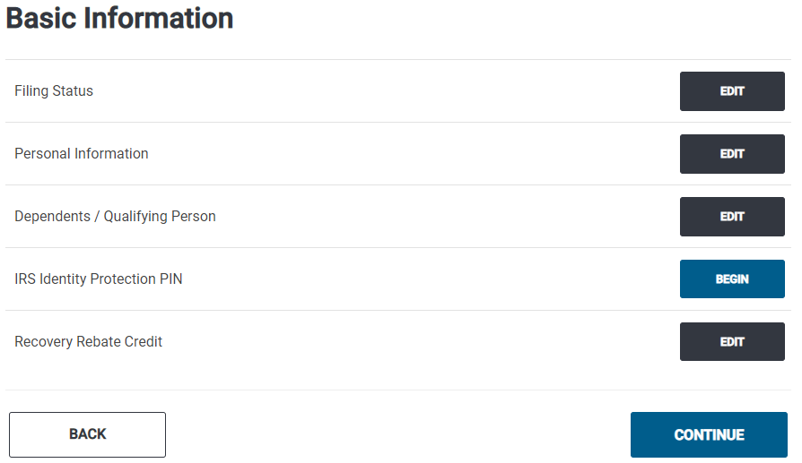
TaxSlayer
Notes:
This is the same as last year
With a different question

Slide 12
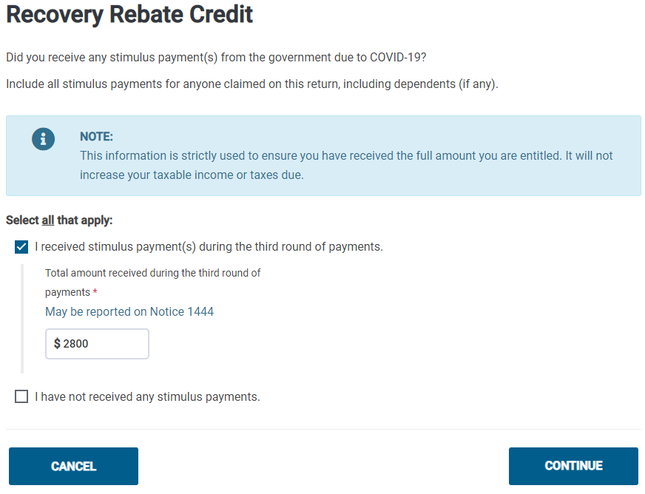
TaxSlayer
Notes:
For most people, the stimulus check payment will equal the tax credit allowed.
This taxpayer received $2800 for the both, him and his son.

Slide 13
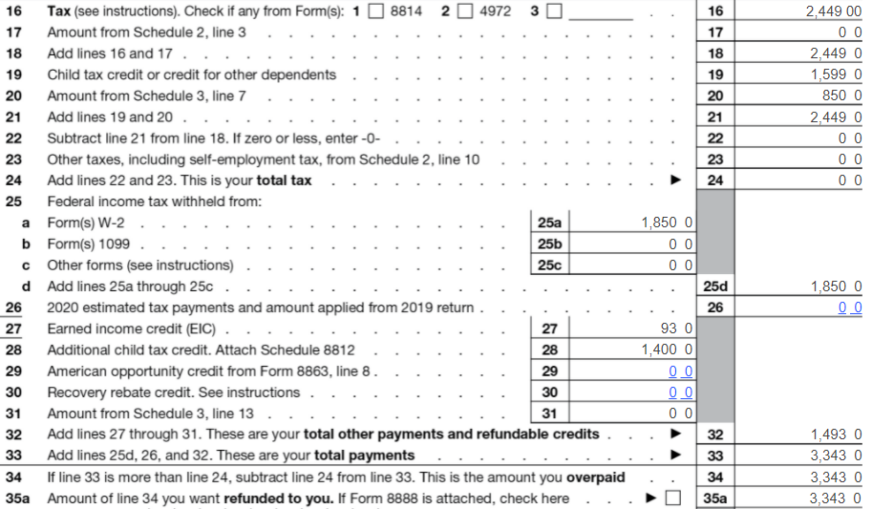
Notes:
In this case, the credit will be reduced to zero.

Slide 14
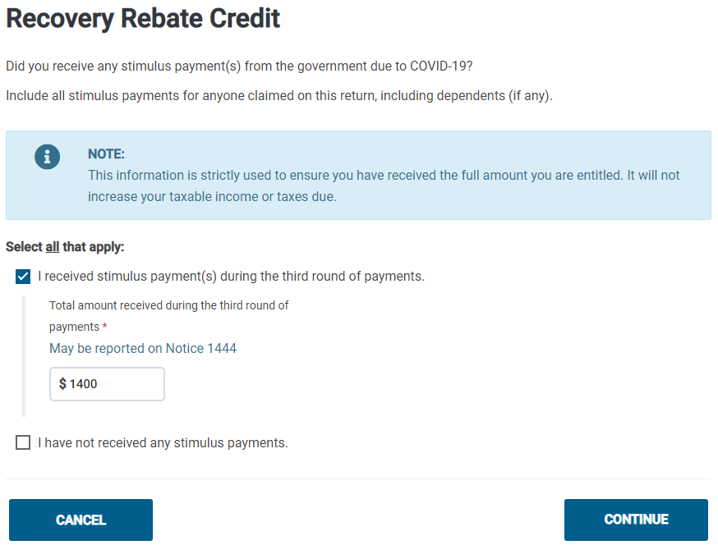
TaxSlayer
Notes:
However, if the stimulus check was less than the credit amount, the tax the taxpayer tax they owe will be reduced by the difference or might even receive a refund.
This is the same taxpayer he received $1400 for the both, him and his son.
Eligible taxpayers who received a smaller-than-expected Economic Impact Payment (EIP) may qualify to receive an additional amount when they file their 2021 federal income tax return

Slide 15
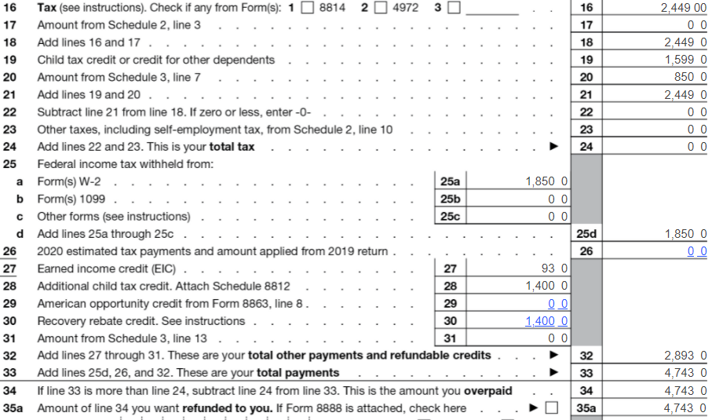
Notes:
In this case the taxpayer will receive the extra $1400 as a refund.
You may be able to claim the recovery rebate credit only if your economic impact payments are less than your credit. This happens when:
– You are eligible but were not issued an EIP 3, or
– Your EIP 3 was less than $1,400 ($2,800 if married filing jointly) plus $1,400 for each qualifying dependent you had in 2021.

Slide 16
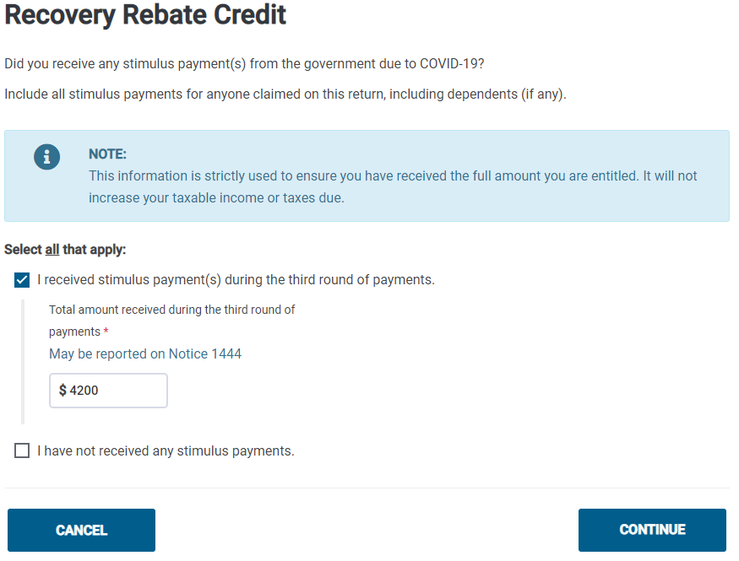
Notes:
In this example the taxpayer his wife had passed away in 2018
He received an extra $1400
If the third-round stimulus check was more than your credit amount
Enter the full amount from the form 1444

Slide 17
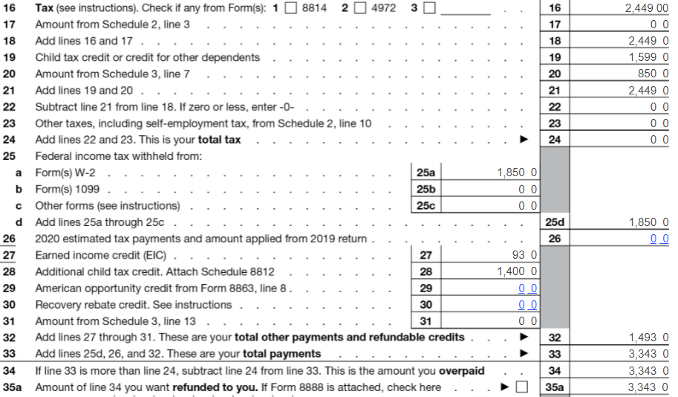
Notes:
The taxpayer won’t have to repay the difference to the IRS.
Also noted the stimulus check receive are not taxable.

Slide 18


Notes:
A lot of information but if you need to ask questions about any tax topic ask and we will help find answers.
We are in this together,

