Slide 1
Amended Returns
Comp
Comprehensive Lesson
Pub 4012 – Tab M Pub 4491 – Lesson 33
Videos: Part 1 and Part 2
Notes:
Note that it is more difficult to practice amending a return using TaxSlayer Practice Lab because original information does not come forward unless the return has been E-filed.
When return being amended available in TaxSlayer (see video Part 1)
When return being amended not available in TaxSlayer (see video Part 2)

Slide 2
Message to Idaho Tax Aide Counselors

Slide 3
Amended Returns
Comp
Returns amended on Form 1040-X
Amend returns for current and previous three years only
Amended returns
Beginning 2019 most returns originally e-filed can now be e-filed
If original return was E-filed (with some exceptions)
Years prior to 2019 must be mailed
Preparer & QR must be certified for year amending

Slide 4
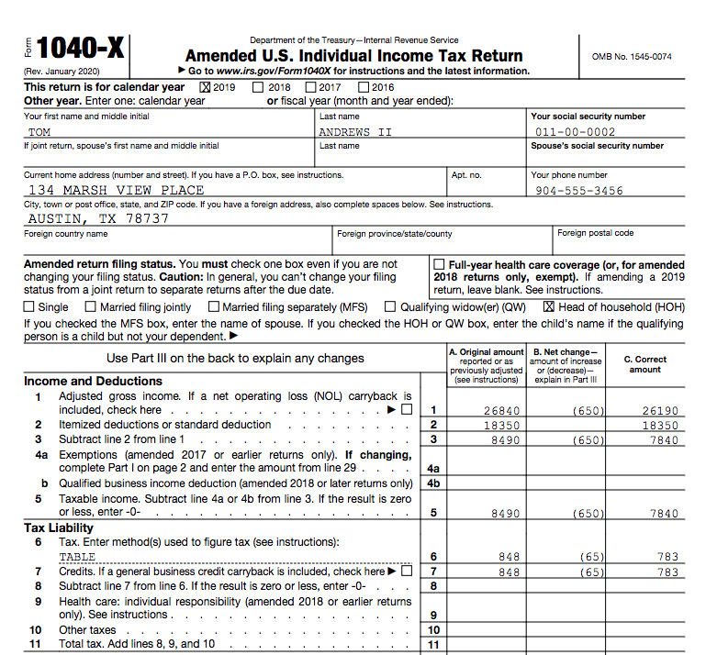
Form 1040-X
Comp
Column A:
Original amounts
Column B:
Net changes
Column C:
Corrected amount
Notes:
TaxSlayer enters correct year amending
Column A amounts must be original OR as previously adjusted, either by the IRS or previous amendment

Slide 5
Reasons to Amend
Comp
Something reported incorrectly or omitted from original return
New or corrected information received by taxpayer
Errors (other than math errors that IRS will correct)
Missing 2020 credits if IRS failed to correct those AGI related reductions (from subtracting out 2020 UCE)
Taxable Social Security or Itemized Deductions
Credits (Retirement, CTC, CDCC, EIC, PTC)
Notes:
5
Amendment may be requested by taxpayer, but if the taxpayer brings in last year’s return do a quick sanity check on it to look for high consequence errors. Examples: Filing status, credits, and adjustments
We will do a practice QR on one of the returns in NTTC Workbook at the end of this lesson and amend the return

Slide 6
Do Not Amend
Comp
Do not amend return if
Math errors
IRS will correct them and send a notice
IRS is using their math error authority to correct Unemployment Compensation exclusion and APTC forgiveness on TY20 returns
IRS has requested taxpayer provide missing schedules/forms
Taxpayer should respond per notice
Example: If taxpayer did not reconcile APTC they get a letter
Notes:
Do not need to amend return only to respond to IRS notice. May want to amend for other reasons but amending to agree with IRS notice is not necessary.
Math errors using tax software rare ... but possible.

Slide 7
Caution When Amending 2020 Returns
Comp
New
Review the printed original return for either:
Unemployment Compensation Exclusion (UCE)
Advanced premium tax credit repayment forgiveness (APTC)
IRS adjustments made during mid-year will not show on the original E-filed return
Ensure these adjustments are included in TaxSlayer before amending a 2020 return
UCE and APTC adjustments should have been completed by year end
Verify credits (such as EIC) that TP is now qualified for with UCE subtracted from AGI

Slide 8
Amending in TaxSlayer
Comp
If original return recently filed
Wait until IRS processes original return before submitting amended return
Except file by April 15 if balance due to avoid interest due

Slide 9
Amending in TaxSlayer
Comp
Steps 1 – 5

Slide 10
TaxSlayer Amended Tax Return Menu

Slide 11
Amending in TaxSlayer: (My method)
Comp
Step 1
Must have a copy of Federal and State returns prior to amending
Print Original Copy 1040 pages 1 & 2 and Form 40 pge 2 if created by AARP Tax Aide using TaxSlayer software, or
Obtain copy of Fed and State returns from Tax Payer

Slide 12
Amending in TaxSlayer: (my method)
Comp
Step 2 (before clicking on “AMEND RETURN”)
Start process with corrected federal & state returns
If the original return is in TaxSlayer, make corrections
If the original return was created elsewhere, duplicate the original information in TaxSlayer & make corrections
Notes:
It is not necessary to duplicate the original return in TaxSlayer – this may be impossible if the original return has errors. However, it is best practice to enter everything from the original return first as a check that nothing was missed, then add the changes.

Slide 13
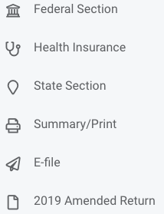
Amending in TaxSlayer: (my method)
Comp
Step 3
Click on 20XX Amended Return in left menu in TaxSlayer
1040-X column C will be created. Columns A & B remain blank
Notes:
Access taxpayer's original return (or previously adjusted return) in TaxSlayer. Verify you are amending the most recent return.
Then click on 20XX amended return from TaxSlayer menu (left side of screen)

Slide 14
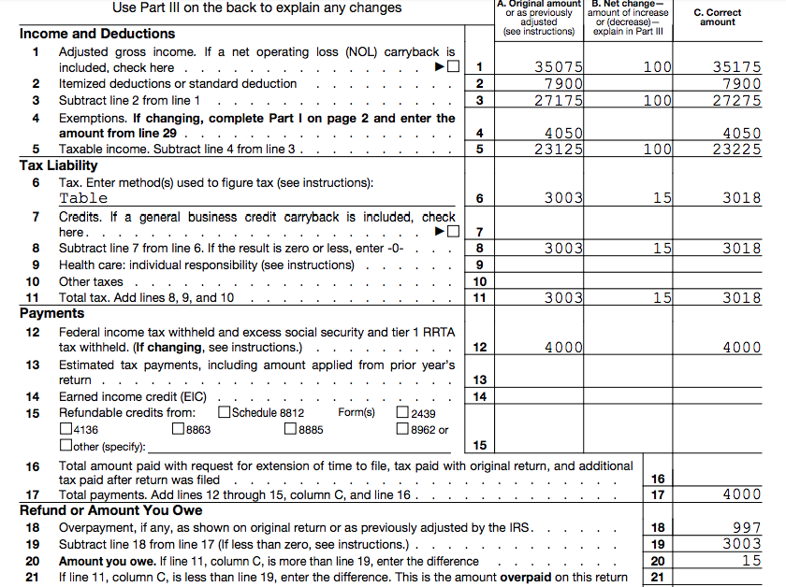
Form 1040-X
Comp

Slide 15
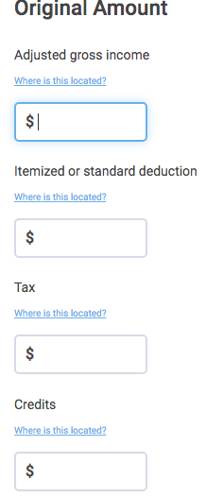
Amending in TaxSlayer:
Comp
Step 3 (cont.)
Using the printed copy of original (or previously adjusted) return
Enter or verify all amounts requested – this creates Column A Form 1040-X
Click on blue link for location of amount requested
Notes:
The amounts entered on this screen become Column A Form 1040-X

Slide 16
Amending in TaxSlayer:
Comp
Step 3 (cont.)
If not adding or removing dependents, uncheck this box
Check the box when adding or removing dependents
enter number of dependents claimed on original or previously adjusted return in appropriate box

Slide 17
Print Form 1040-X
Comp

Slide 18
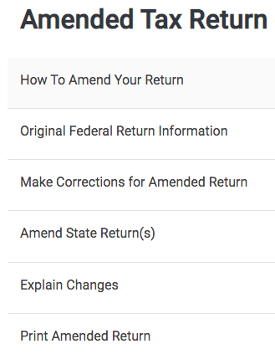
Amending in TaxSlayer
Comp
Step 4
View 1040-X for accuracy
Explain all changes

Slide 19
Amending in TaxSlayer—Explanations
Comp

Slide 20
Amending in TaxSlayer:
Comp
Step 5
Click on Amend State Return (if the state return is affected)

Slide 21
Amending the Idaho Return (Summary)
Print or obtain a copy of the original filed state return
Tax refund on original return
Tax paid with the original return
Start the process with a corrected return
Click on “Amend State Return”
Tell TaxSlayer you want to amend the state return 3 more times
Provide reason for amending, then add tax paid/refunded with the original return
TaxSlayer calculates additional tax due or additional refund
Explain the changes on 1040-X page 2, then print Idaho Form 40
Notes:
In some cases, the federal return does not need to be amended, but use the 1040-X page 2 to explain the changes

Slide 22
Amending the Idaho Return (once)
Notes:
In some cases, the federal return does not need to be amended, but use the 1040-X page 2 to explain the changes

Slide 23
Amending the Idaho Return (twice)
Notes:
In some cases, the federal return does not need to be amended, but use the 1040-X page 2 to explain the changes

Slide 24
Amending the Idaho Return (thrice)
Answer “YES”
Notes:
In some cases, the federal return does not need to be amended, but use the 1040-X page 2 to explain the changes

Slide 25
Amending the Idaho Return (at last)
Add refund or tax paid
-- Select –
Federal Audit
Capital Loss Carryback
Federal Amended
Other
Notes:
In some cases, the federal return does not need to be amended, but use the 1040-X page 2 to explain the changes

Slide 26
Step 6: Printing Amended Return
Comp
Print Form 1040-X and all new and any changed forms or schedules
If mailing, print two copies plus an additional Federal copy if needed for state amendment
Print from Amended Tax Return screen
Notes:
Chart found in Pub 4012, Tab M
Two copies: one for federal and one for taxpayer – additional copy for state if needed
For example: If 1040X includes Schedule A itemized deductions with medical expenses, include a copy of Schedule A in packet if AGI has changed

Slide 27
Where do you send federal amended returns?

Slide 28
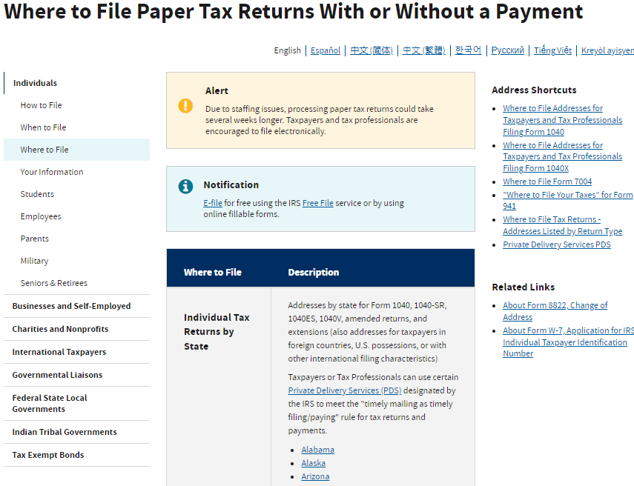
Finding Correct Address for Idaho Amended Returns

Slide 29
Statute of Limitations – Refund
Comp
Taxpayer time to file for refund later of:
3 years from original due date or actual date filed if later
2 years from date tax was paid

Slide 30
Amended Returns
Comp
Comments ...
Questions?

Slide 31
Time to Practice (NTTC Workbook page 58)
1. Identify any errors (Quality Review Karen Chambers)
2. Treat the return as if it was 2020 information (because state menus not yet available for 2021)
3. Amend the Federal and state returns

Slide 32
Karen Chambers - NTTC Workbook – page 58
Take a couple of minutes
Do a Quality Review
Identify any errors
Amend Federal Return
Amend State Return

