Slide 1
Refundable Tax Credits -2021
Earned Income Credit
Child Tax Credit
Child and Dependent Care Credit

Slide 2
CDC Covid Tracker - Determines Service Models in 2021
Current Status – 12/9/2021
Status – 02/01/2021

Slide 3
The start of last years tax season - frustrating!
What were the Fishers doing in Feb 2021?
Northern Idaho has a lot of red necks
The Fishers stayed productive

Slide 4
Deb protecting her COVID Supplies

Slide 5
The Fisher’s 2nd Line of COVID Defense – Warren

Slide 6
There is now a more efficient way to distribute tax dollars
New Rules for EIC, RCTC & CDCC - 2021

Slide 7
Earned Income Credit
Pub 4012 – Tab I
Pub 4491 – Temporary Provisions and Lesson 29
Notes:
This presentation covers the following topics:
EIC Rules
Qualifying child of more than one person
EIC Disallowance in a prior year (comprehensive topic)
The presentation contains several EIC examples in a quiz format to engage volunteers in using resource materials to determine EIC eligibility.

Slide 8
2021 Changes to Earned Income Credit
New
Applies to 2021 returns only
Minor adjustments to range and maximum for taxpayers with qualifying children
Significant expansion for taxpayers with no qualifying children
Available to younger workers and senior citizens
Eligible income range expanded
Maximum credit is nearly tripled compared to TY20

Slide 9
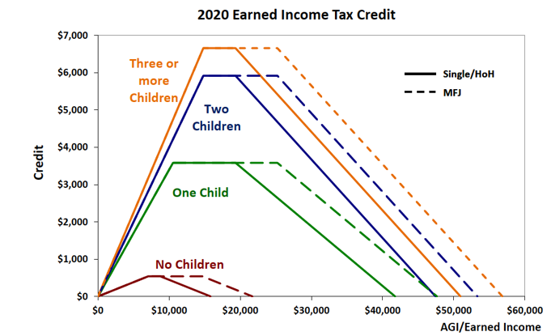
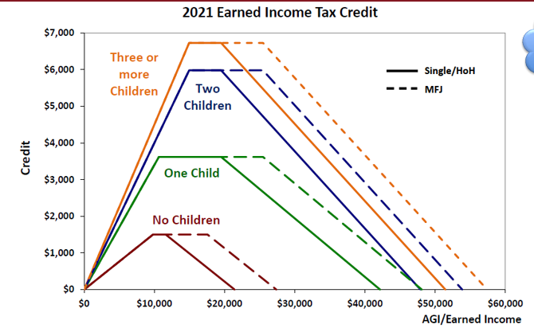
Amount of the Credit 2020/2021 Comparison
Applies to 2021 returns only
From $6,660 to $6,728
From $5,920 to $5,980
From $3,584 to $3,618
From $538 to $1,502

Slide 10
Use of 2019 earned income
Applies to 2020 and 2021 returns only
New
Taxpayers may use 2019 earned income if higher than 2021 earned income to figure their EIC
2019 earned income was also allowed to be used on the 2020 return if higher than 2020 earned income
Includes taxpayers with no earned income in 2021
Input on TaxSlayer basic information page
Note that self-employed earned income is Schedule C profit less deductible part of self-employment tax
Notes:
2020 earned income CANNOT be used on 2021 returns

Slide 11
Changes to Earned Income Credit for 2021
New
Applies to 2021 returns only
For taxpayers with “no qualifying children”
Minimum age decreased to age 19 (was 25)
Except to age 24 for specified students, if not qualified former foster or homeless youth
Same eligible student definition as for American Opportunity Credit
Except age 18 for qualified former foster youth or homeless youth
Maximum age removed (was 65)
EIC calculation is based upon lower of AGI or earned income
Social Security Income only affects EIC if it increases AGI
Notes:
The term ‘qualified former foster youth’ means an individual who was in foster care on or after the date that he or she turned 14 years old.
The term ‘qualified homeless youth’ refers to an individual who certifies that he or she is either an unaccompanied youth who is a homeless child or youth, or is unaccompanied, at risk of homelessness, and self-supporting.
An individual who meets either of these definitions and qualifies to claim the EITC without a qualifying child under age 19 must check a box on Form 1040 to certify that they meet these requirements.
An eligible student is one who is enrolled in a degree program at an accredited institution at least half time during at least 5 months during the tax year

Slide 12
Changes to Earned Income Credit
New
Starting 2021
Taxpayer with a child who does not have SSN can claim EIC the same as if “no qualifying children”
Taxpayer (and spouse if filing MFJ) still must have a valid SSN
Permanent change

Slide 13
Investment income limit raised starting 2021
New
Permanent change
Qualify for EIC if investment income is $10,000 or less
Was $3,650 for 2020
Investment income includes:
Interest, including tax-exempt interest
Dividends
Capital gains
Capital gain distributions
Income from residential rental property (out of scope)

Slide 14
MFS may be able to claim EIC – new starting 2021
New
Permanent change
Married, not filing a joint return
Qualifying child lived with taxpayer more than ½ the year
Lived apart from spouse last six months of year or are legally separated and did not live in the same household with spouse at the end of the year
New check box on Schedule EIC to indicate this
MFS is still Out of scope for AARP TaxAide in Idaho. Use HoH if TP pays for > ½ upkeep of the home
Notes:
Legal separation must be according to state law with a legal separation agreement or a decree of separate maintenance

Slide 15
Earned Income Credit Quiz #1
Sage Senior, age 68 and single, worked part time for Walmart for the past 5 years making federal minimum wage.
She retired and began receiving Social Security and retirement benefits in 2021 (no federal or state tax withholding)
2021 Income: Soc. Sec. = $10K, & 1099-R = $8K. (No wages)
Does Sage have a filing requirement?
Should she file a tax return? Why?
2019 earned income

Slide 16
Earned Income Credit Quiz #2
Maria (age 20, with valid SSN) files HoH in 2021 based upon her two young children that lived with her all year. Her kids have ITINs
Maria worked for Arby’s since age 16 as a cook but was laid off from her job in December 2020 due to COVID related decrease in business
She took 6 hours per semester at CEI while looking for work all year, and received $12K in unemployment benefits
She had no wages in 2021
Is Maria entitled to claim Earned Income Credit in 2021?
Possibly, based upon 2019 earned income

Slide 17
Earned Income Credit Quiz #3
Maria (age 20, with valid SSN) files HoH in 2021 based upon her two young children that lived with her all year. Her kids have ITINs
Maria worked for Arby’s since age 16 as a cook but was laid off from her job in December 2020 due to COVID related decrease in business
She took 12 hours per semester at CEI while looking for work all year, and received $12K in unemployment benefits (no wages)
Is Maria entitled to claim Earned Income Credit in 2021?
No, she is a full time student

Slide 18
Quiz #4 Earned Income Credit
Amy Harris (age 20, Single, valid SSN) went on an 18 month church mission beginning 4/1/2021
2021 wages = $4500 with no tax w/h. 2019 wages = $9000
Amy completed her first year in college in 2020 but did not go to school in 2021
Amy’s father (Terry Baldwin) received $2800 EIP for himself and Amy
Does Amy have a filing requirement?
Should Amy file a tax return in 2021? Why?
Earned income credit and EIP is available to her

Slide 19
Quiz #5– Which of the following types of income is Earned Income?
Review Pub 4012 Tab I-1: Earned or unearned income?
Disability pension or annuity when taxpayer is under minimum retirement age?
Alimony received?
Pay for work performed while an inmate at a penal institution?
On work release? Living in a halfway house?

Slide 20
Qualifying Child of More than One Person
Tiebreaker rules: more than one taxpayer can claim a child
Only one the parent, parent wins
Both parents can claim child, custodial parent wins
Child in custody of both parents, same amount of time, parent with higher AGI wins
If a parent could—but neither does—claim the child, another family and household member, whose AGI is greater than either parent’s, may be able to claim the child. (but must take all the benefits)
Neither is parent, taxpayer with highest AGI wins
Use the Qualifying Child or Relative Resource Tool – will walk through all requirements
Notes:
Instructor note: Instructors can have volunteers use Resource Tool and walk-through some of the examples on slides 12-15
Custodial parent is the parent the child lives with the majority of the time

Slide 21
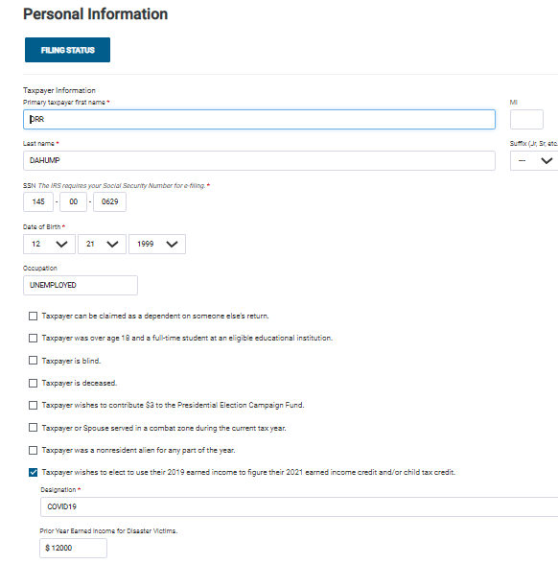
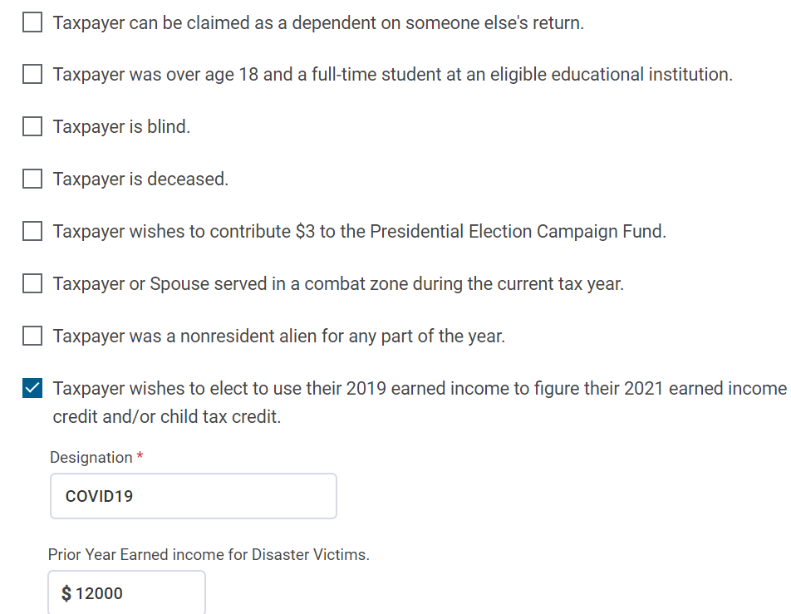
Entering Taxpayer Personal Information in TaxSlayer
Information entered here will determine if the age, relationship, and residency rules are met.
Notes:
Class should become familiar with the additional questions as they impact EIC and other tax benefits

Slide 22
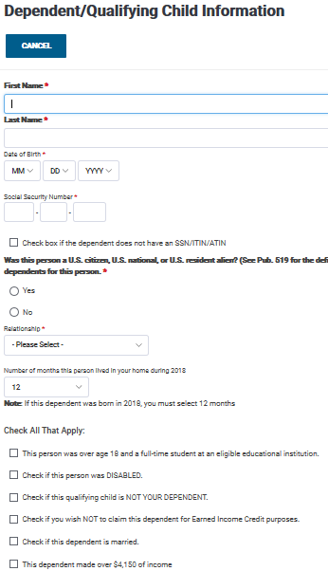
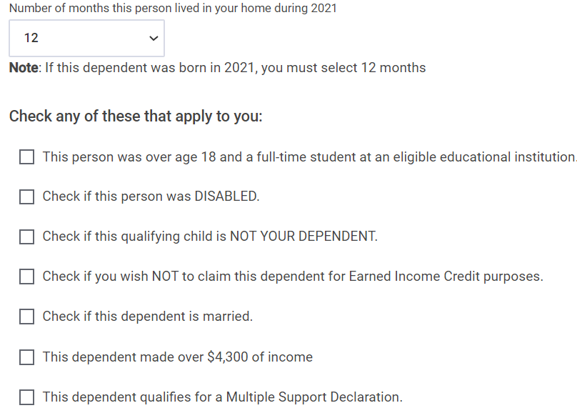
Entering Dependent/QC Information in TaxSlayer
Information entered here will determine if the age, relationship, and residency rules are met.
Notes:
Class should become familiar with the additional questions as they impact EIC and other tax benefits

Slide 23
Earned Income Credit
Questions?
Comments…

Slide 24
Go To Practice Lab and pull up Terry Baldwin Return
Notes:
NTTC Work book page 57. (A typical case for self employed older person)

Slide 25
Go to NTTC Workbook page 57. (Terry Baldwin)
Summary of the Terry modified Baldwin Scenario
Terry (widowed in 2016) has a daughter - Amy Harris - who lives w/ him >1/2 year
Amy, age 20, has wages of $10K from Montana as a ski instructor
Was dependent in 2019 with $11K income
Terry - Self Employed w/ 2 NEC forms ($3.3K & $5.5K) and cash income of $30,675
Received $2800 EIP in 2021
Is Terry entitled to EIC?
What if Terry’s income was lower?
What if Terry was > age 65?
Does Amy have a filing requirement?
Should Amy file a state or federal tax return?

Slide 26
Child Tax Credit And Credit for Other Dependents
Pub 4012 – Tab G
Pub 4491 – Lesson 24 and Temporary Changes
Notes:
This presentation covers the changes in place for TY2021 including refundable CTC (RCTC) and advanced child tax credit (AdvCTC) payments. The rules for those not eligible for the RCTC are also covered.

Slide 27
New and old Terms for Child Tax Credit in 2021
Go To Pub 4012, Pages G-1 thru G-5
Child Tax Credit (CTC)
Other Dependent Credit
Additional Child Tax Credit (ACTC)
Refundable Child Tax Credit (RCTC)
Advance CTC Payments (Advanced CTC)
Repayment Protection

Slide 28
Child Tax Credit and Additional Child Tax Credit
New
For those that did not live in the U.S. more than half of 2021, or make too much money, the rules are the same as in 2020:
Child Tax Credit is nonrefundable (up to $2000)
Refundable portion up to $1,400 as Additional Child Tax Credit (ACTC)
Must have more than $2,500 earned income to qualify for refundable portion
Amount of CTC is linked to the amount of earned income > $2500
May get refundable portion with three or more children regardless of income

Slide 29
RCTC, CTC and ACTC Taxpayer Qualifications
Pub 972
Income phase out range – Modified Adjusted Gross Income Limits
Married Filing Jointly - $400,000 to $440,000
All other filing statuses (including MFS) - $200,000 to $240,000
Cannot claim foreign income exclusion
File Form 8862 if a refundable credit was disallowed in prior year and received IRS letter to file the form
Notes:
Pub 972 – Child Tax Credit

Slide 30
Form 8862 for reinstating EIC, ACTC or AOC

Slide 31
Child Tax Credit and Refundable Child Tax Credit
New
For those that did live in the U.S. more than half of 2021, the rules are substantially different:
Earned income is not required to qualify for refundable credit
Refundable credit (RCTC) = $3600 for “Qualifying Child” under age 6
Refundable credit (RCTC) = $3000 for “Qualifying Child” under age 18 (not < 17)
Half the total RCTC can be paid in advanced monthly payments
Taxpayer or Spouse with SSN or ITIN are eligible for RCTC
Child must be a U.S. citizen, U.S. national, or U.S. resident alien with valid SSN by filing deadline

Slide 32
Refundable Child Tax Credit for 2021
New
Applies to 2021 returns only
The increased amount of CTC phases out starting at MAGI above:
That is, the additional $1,000 ($3,000-$2,000) or $1,600 ($3,600-$2,000) if under age 6 will phase out
MFJ | $150,000
HoH | $112,500
Others | $75,000

Slide 33
IRS Letter 6419 issued to Adv CTC recipients
New
Applies to 2021 returns only
Jan 2022: IRS sends Letter 6419 to all taxpayers showing
total monthly Advanced Child Tax Credit dispersed in 2021
Total number of children who qualified for Advanced CTC, based upon the most recent 2020 or 2019 tax returns.
Counselors must enter these two totals to calculate the additional tax credit due, or excessive payment that potentially must be paid back

Slide 34
Additional TaxSlayer Entries (Not currently available)
Credits (See placeholder in TaxSlayer)
Enter the number of qualifying children used in determining the advance amount found on Letter 6419
Enter the aggregate amount of advance CTC payments from Letter 6419

Slide 35
RCTC / CTC / ACTC and TaxSlayer
TaxSlayer:
Automatically determines credit eligibility and amount by the information entered
Completes Schedule 8812
If the result is not as expected, review your entries

Slide 36
Repayment of Advance Payments of RCTC for 2021
New
Applies to 2021 returns only
Taxpayers to reconcile advance payments with actual credit allowed on 2021 return
Excess advance payments treated as additional tax for some TPs
The additional tax may be reduced if
MAGI does not exceed twice the threshold
Thresholds are MFJ $60,000, HoH $50,000, Other $40,000
– and the reason for excess advanced payments is –
More children were included in the Advanced CTC than the actual number of qualified children on the return
Notes:
The IRS used the 2020 return (or the 2019 return if no 2020 return was filed) to estimate the number of children for whom Advanced CTC payments would be made. The intent was to send ½ of the RCTC as advanced payments. The number of children used will be included in the letter the IRS sends in January
Taxpayers could opt out or change the number of qualifying children through an online portal

Slide 37
Seizure of Advanced CTC Payments
Advanced CTC portion of refund cannot be seized to pay past-due child support, student debt or overdue taxes
Remaining refund after figuring the 2021 taxes can be seized to offset other debt.

Slide 38
Schedule 8812 (for calculating CTC, RCTC)
Part I-A
1. Calculates maximum allowable CTC & “Other” TC based upon number/age of children and AGI of TP
2. Checking the box in step 13 determines whether RCTC is fully refundable
Step 2

Slide 39
Schedule 8812 (for calculating CTC, RCTC, & “Other”CTC)
Part I –B
Reconciles amount of Advanced CTC received and determines if (a) additional RCTC is due or (b) whether too much was received.
Directs “Other” tax credit to nonrefundable credits.
Directs RCTC to refundable section of 1040

Slide 40
Schedule 8812 (for calculating CTC & ACTC
Part I-C
Calculates Nonrefundable Credit for “Other” dependent
Calculates refundable additional tax credit for those who do not qualify for RCTC

Slide 41
Schedule 8812 (for calculating CTC, & ACTC - < 3 kids)
Part II –A
Adds combat pay to earned income
Calculates CTC. (15% of earned income >$2500)

Slide 42
Schedule 8812 (for calculating CTC, & ACTC > 3 kids)
Part II – B and Part II-C
1. Calculates CTC & Advanced CTC for taxpayers who did not live in U.S. 182 days and w/ > 3 kids.
Smaller of
15% income >$2500
Sum of payroll taxes paid

Slide 43
Schedule 8812 (calculating excess AdvCTC & any repayment)
Part III
Repayment of excess Advanced CTC required if
Advanced CTC was paid, based on greater number of children than actual under age 18 and
AGI is above threshold limits

Slide 44
Child Tax Credit – 2021 Summary
Refundable Child Tax Credit (RCTC) for TP who lived in US > 1/2 year
No earned income required for the credit in 2021
RCTC phases out when AGI exceeds limits
Up to $3K for each child (w/ SSN or resident alien) between ages 6 and 17
Up to $3.6K for each child w/SSN or resident alien) under age 6
Additional Child Tax Credit (ACTC) for TP who lived in US < ½ year
More than $2,500 of taxable earned income
Have at least one qualifying child.
Three or more children may also be eligible w/o earned income
Limited to $1,400 per qualifying child

Slide 45
Quiz #1 Child Tax Credit in 2021
G I Joe and his wife Jane have two children, ages 3 and 5
GI Joe serves in the military and was stationed in Germany with his family from June thru December 2021
GI Joe and Jane wife received $3600 Advanced CTC beginning in July based upon their 2020 tax return
GI Joe’s income (wages only) was $65K. Jane had no income
How much RCTC are the Joe’s entitled to?
How much Additional CTC are they entitled to?
$3600 (Domiciled in US > ½ year)

Slide 46
Special Rules for Divorced or Separated Parents
Child can be treated as a dependent of noncustodial parent if all apply
Parents divorced, legally separated or lived apart last 6 months of the year
Child received over half of their support from one or both parents
Child was in custody of one or both parents over half the year
Signed Form 8332 Release/Revocation of Release of Claim to Exemption for Child by Custodial Parent or pre-2009 divorce or separation decree attached to the return
Notes:
Signed Form 8332 releases dependency exemption to non-custodial parent
Post-1984 and Pre-2009 divorce decree rules exist and should be researched when applicable. Rules are in Pub 4012 Tab G and Form 1040 Schedule 3 instructions
Post-2008 divorce cannot include decree with return – MUST include signed Form 8332

Slide 47
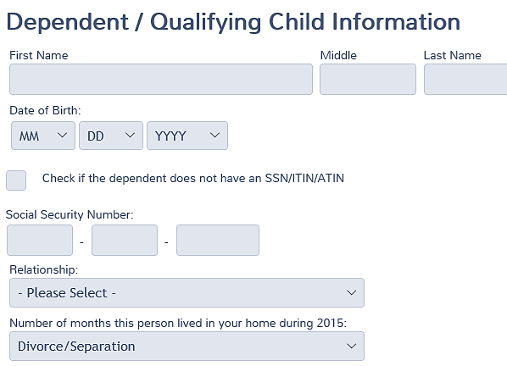
Entering in TaxSlayer
In case of divorce or separation:
Noncustodial parent enters “Divorce/Separation” from drop down menu for number of months in home
Notes:
In order to have the Child Tax Credit applied to the noncustodial parent, Divorce/Separated must be selected from the dropdown menu for number of months in the home. Caution: Entering zero months will not provide the credit.

Slide 48
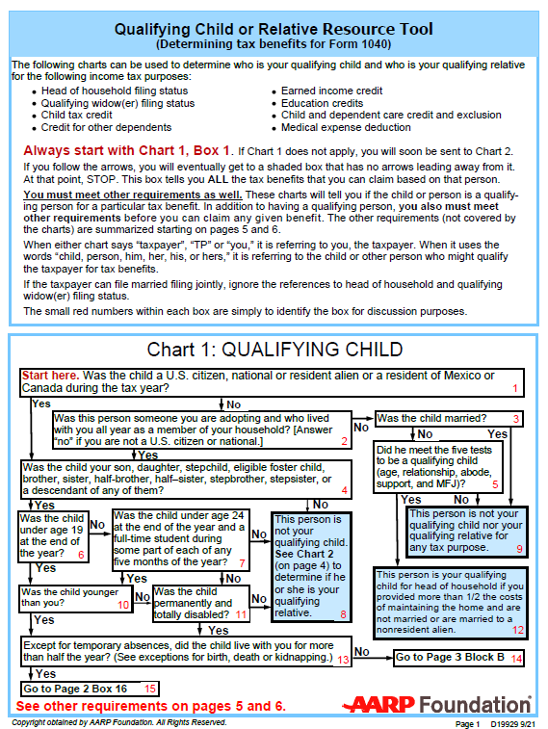
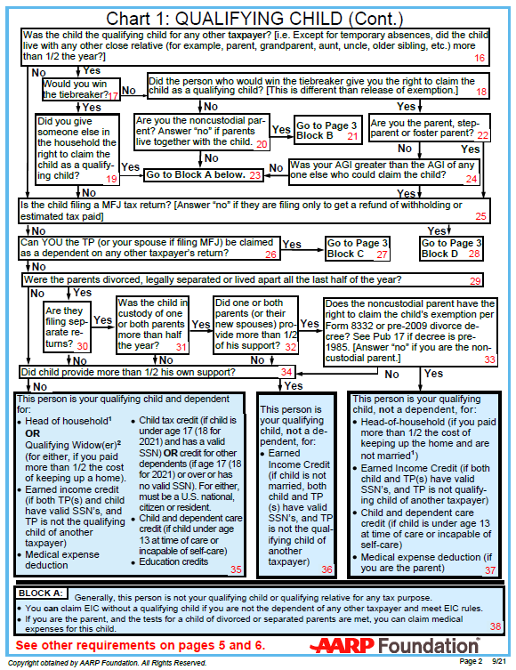
Qualifying Child or Relative Resource Tool
Use the Charts to verify eligibility for RCTC / CTC / ACTC
Notes:
Credit goes with the dependency exemption. Must be qualifying child—not qualifying relative. If the custodial parent releases the exemption, non-custodial parent eligible for the child tax credit.

Slide 49
Credit for Other Dependents

Slide 50
Credit for Other Dependents
Available for claimed dependents that do not qualify for Child Tax Credit
May be Qualifying Child or Qualifying Relative
Includes dependents of any age
Qualifying dependent may have Social Security number or ITIN or ATIN
Must be U.S. citizen, U.S. national, or U.S. resident alien
Notes:
Residents of Canada and Mexico may be dependents but do not qualify for this credit (unless they are also U.S. citizens or nationals)

Slide 51
Credit for Other Dependents
$500 per qualifying dependent
Nonrefundable credit
Income phase out
Married Filing Jointly - $400,000
All other filing statuses - $200,000
Credit not allowed for taxpayer or spouse
TaxSlayer automatically computes credit based on entries
Notes:
Like CTC, TaxSlayer computes automatically based on information entered in dependent section
Taxpayers used to be able to claim their spouse’s exemption deduction in certain cases
That deduction is gone and there is no offsetting replacement

Slide 52
Child Tax Credit, Additional Child Tax Credit and Credit for Other Dependents
Questions?

Slide 53
Child and Dependent Care Credit
Pub 4012 – Tab G
Pub 4491 – Lesson 21
Video: Child and Dependent Care

Slide 54
Child and Dependent Care Credit for 2021
New
Applies to 2021 returns only
NOW Refundable (was nonrefundable)
Taxpayer (or spouse, if MJF) must have a principal place of abode in the U.S. for more than half the year
Remains nonrefundable if abode is outside U.S.
TaxSlayer must add a new box in 2021 software (somewhere?)
TaxSlayer not yet updated for this change

Slide 55
General Rules
Pub 503
Expenses paid for taxpayer and spouse to work or look for work – Expenses must be paid for care – not education
Both taxpayer and spouse (if MFJ) must have earned income
Expenses eligible are limited to the lower of the two earned incomes
Unless one spouse is incapable of self-care or full-time student
Special rule for deceased spouse (deemed income not necessary)
Cannot file MFS (exceptions – comprehensive topic - Rare)
A new box to check on page 2 of TaxSlayer 2441 menu for TP who is filing MFS but, a) can’t file HoH due to not providing > ½ maintaining the upkeep of the home but spouse gone last half of the year.
Notes:
Pub 503 – Child and Dependent Care Expenses
Instructors can use this slide to review and reinforce the information following the volunteers’ review of Pub 4012 Tab G
In community property states, earned income is determined for each spouse without regard to community property laws
Note there is a special section on the Form 2441 if taxpayer or spouse is incapable of self-care or a student.
MFS discussion is a comprehensive topic discussed at the end of this presentation. There are two rare exceptions.

Slide 56
Earned Income Requirement
Taxpayer or spouse can have deemed earned income if a full-time student (at least 5 months during the year) or incapable of self-care
$250 per month ($500 if care is for more than one qualifying person)
Use actual earned income for the month if higher
Taxpayer or spouse can have deemed income in a given month but not both
Surviving taxpayer filing MFJ in year of spouse’s death
May ignore deceased spouse’s earned income
Notes:
If the taxpayer or spouse is a full-time student (at least 5 months) or is incapable of self-care, they are deemed to have earned income of $250 for each month they are full-time student or incapable of self-care($500 if more than one qualifying person was cared for)
Note that the amount of deemed earned income has NOT changed in 2021. The maximum expenses allowed when one spouse was a student or incapable of self-care for the entire year is $3,000 ($6,000 if more than one) – Even though the maximum expenses if both spouses work was increased to $8,000 or $16,000.
If taxpayer and spouse are full-time students or incapable of self-care, in a month, only one can have the deemed earned income
If the student or incapable of self-care TP or SP also worked, use the higher of the deemed amount or their actual earned income for that month
A surviving spouse can choose to use only their own earned income to limit the eligible expenses. This is beneficial when the deceased spouse had little or no earned income.

Slide 57
Qualification Requirements – Pub 4012 Tab G
Who is a qualifying person?”
“Qual Child” under age 13
Dependent who is incapable of self care who lives in the home (or could have been a dependent except >$4300 income)
Spouse who is incapable of self care
“What are qualified work-related expenses?”
No change from 2021
Notes:
Have students find the answers in Pub 4012
Who is a qualifying person?
A qualifying child who was under the age of 13 when the expenses were incurred and who can be claimed as a dependent, see the first caution below.
Any person who was incapable of self-care* whom the taxpayer can claim as a dependent or could’ve been claimed as a dependent except that the person had gross income of more than $4,300 or filed a joint return or that the taxpayer or spouse, if married filing jointly, could be claimed as a dependent on someone else’s 2021 return.
A spouse who was physically or mentally incapable of self-care*.
*Incapable of self-care - persons who can't dress, clean, or feed themselves. Also, persons who must have constant attention to prevent them from injuring themselves or others.
The qualifying person must live with the taxpayer more than 1/2 the year.
See Publication 503, Child and Dependent Care Expenses, for special rules regarding divorced or separated parents or parents who live apart.
Qualified work-related expenses
Expenses must be paid for the care of the qualifying person to allow the taxpayer and spouse, if married, to work or look for work.
The care includes the costs of services for the qualifying person’s well-being and protection.
Expenses to attend kindergarten or a higher grade aren’t an expense for care.
Expenses for summer day-camp are qualifying, but those for overnight camp aren’t.

Slide 58
Child and Dependent Care Credit for 2021
New
Applies to 2021 returns only
Maximum expenses eligible increased to $8,000 ($16,000 for more than one qualifying person)
Was $3,000 ($6,000 for more than one)
2020 expenses paid in 2021 are subject to 2020 limits
Employer carryover of dependent care benefits not taxable in 2021 or 2022
Maximum credit is now 50% of expenses (was 35%)
Income phase-down of percentage begins at AGI of $125,000 (was $15,000)
New high-income phase out begins at $400,000
Notes:
Eligible expenses are limited to the taxpayer’s earned income
If MFJ, expenses are limited to the LOWER of the two earned incomes (or deemed earned income)
Credit percentage is lowered to 20% at $183,000 and now phases out to 0% starting at $400,000

Slide 59
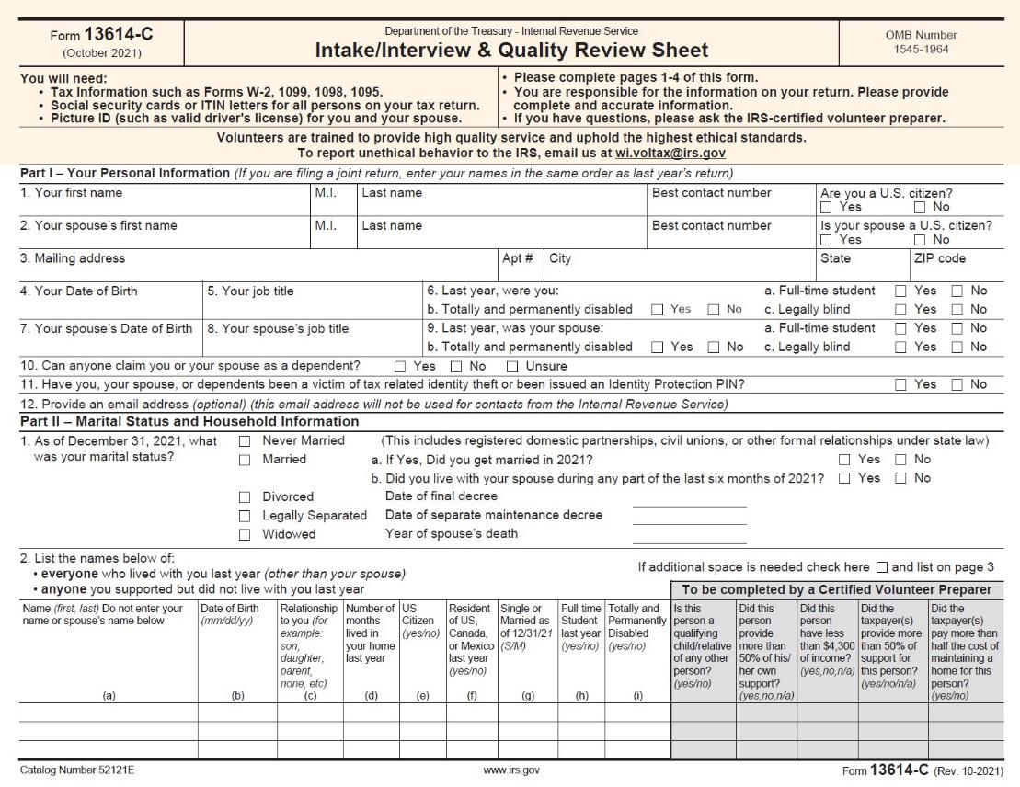
Intake Booklet
Being disabled may be an indicator of needing care and useful if filing MFJ
Notes:
What are hints that this credit might apply?
Note “Disabled” is not enough – the criteria is that the person be “incapable of self-care” so probing questions need to be asked. Many people who are disabled in some manner are still capable of self care. Likewise, someone temporarily incapable of self-care may not be permanently disabled.
Incapable of self-care: Physically or mentally not able to care for oneself. Persons who cannot dress, clean, or feed themselves because of physical or mental problems are considered not able to care for themselves. Also, persons who must have constant attention to prevent them from injuring themselves or others are considered not able to care for themselves.
Permanently and totally disabled: A person is permanently and totally disabled if both of the following apply:
He or she cannot engage in any substantial gainful activity because of a physical or mental condition.
A doctor determines the condition has lasted or can be expected to last continuously for at least 12 months or can lead to death.
Caution: TaxSlayer will not add a dependent or qualifying person to Form 2441 unless they are marked as “Disabled” – this should be marked if they are incapable of self-care whether or not they are permanently and totally disabled.

Slide 60
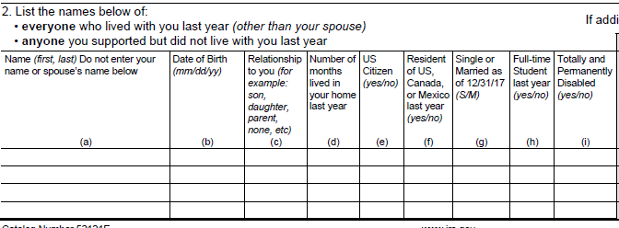
Intake/Interview
Intake Booklet
Under age 13?
Being disabled may be an indicator of needing care if age 13 or older
More than 6 months?
Notes:
Qualifying children under 13 qualify up until their 13th birthday – calculate partial year
If dependent is incapable of self-care, qualify at any age. Note “Disabled” is not enough – the criteria is that the person be “incapable of self-care” so probing questions need to be asked. Many people who are disabled in some manner are still capable of self-care.
See definitions for disabled and incapable of self-care on back of Qualifying Child/Relative Tool
See: https://www.irs.gov/instructions/i2441, also Pub. 501, Exemptions, Standard Deduction, and Filing Information

Slide 61
Caregiver Rules
Cannot be spouse or dependent
Cannot be taxpayer’s child under age 19
Cannot be child’s parent (with some exceptions for adults needing care)
Provide name, address and identifying number
Taxpayer must use due diligence to get information
Notes:
Instructors can use this slide to review and reinforce the information following the volunteers’ review of Pub 4012 Tab G Screening Sheet
If you can’t get the EIN, SSN or ITIN for the provider you cannot e-file and must complete an explanation on the back of Form 2441.
If caregiver is your employee, and total payments were more than $2000, then Schedule H for household employees is required, and return is out of scope.

Slide 62
Employer-provided Benefit
Credit is based on taxpayer’s out of pocket expenses
Employer childcare benefits are not included
TaxSlayer automatically deducts Form W-2 box 10 amount
Enter total paid by taxpayer (before employer reimbursement) on Form 2441 Page 1 input form
Notes:
These appear on W-2 Box 10 and are included in income on Line 7 until Form 2441 is completed
If benefits were received that are not on Form W-2, enter the amount on TaxSlayer Form 2441 page 2
Amounts on Form 2441 Part II – 2(a) must not show more than the net amount of expenses paid
For 2021 and 2022, employers may allow employees to carry over benefits from the previous year and may reimburse from these for expenses to care for a child who is now 13 years old (and ineligible for the credit). At this writing, it is unclear how or if such expenses will be accounted for in TaxSlayer.

Slide 63
Child and Dependent Care Assistance for 2021
New
Applies to 2021 returns only
Exclusion for employer-provided dependent care benefits increased to $10,500 ($5,250 if MFS)
Was $5,000
Shown on W-2 in box 10

Slide 64
Child and Depedent Care Quiz 1
Married taxpayers earned $30,000 each during the year and have 2 qualifying children
One child is cared for at no expense by neighbors
The second child had qualifying day care expenses of $10,000 during the year
What expense amount is used to calculate the child and dependent care credit?

Slide 65
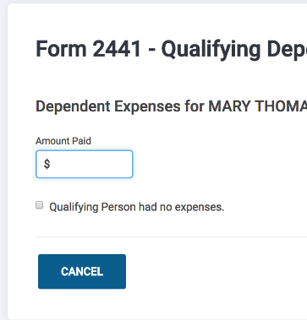
Child and Dependent Care Quiz 1 (cont’d)
$10,000
Even though there are no out of pocket expenses for the first child, they have two children that qualify for the child and dependent care credit. Check the box for the second child with no expenses.
Notes:
Learners can find this in Pub 4012 page G-7 at the bottom of the page as a caution

Slide 66
State Deduction for Child and Dependent Care
IRS Tax Code was revised in March 2021. Idaho has not yet agreed to conform to those new changes
We will not know whether Idaho Legislature will conform to IRS Code until after the legislature reconvenes in January 2022
The amount of CDCC has increased from a maximum of $6K to $16K and is now a refundable credit.
TaxSlayer for state can not be changed until after legislature acts
The CDCC deduction for state may not remain at maximum $6K
The CDC deduction may have to be reduced by amount of the federal refund, i.e., calculate net cost of dependent care to TP

Slide 67
Child and Dependent Care Credit
Questions?
Comments?

Slide 68
Go to NTTC Workbook page 58. (Karen Chambers)
Summary of the revised Karen Chambers Scenario
Karen & John filing MFJ. Mark died in January 2021. (John was permanently disabled)
Karen’s Income:
Military pension - $27,117 Soc Sec Benefits - $12,345
Disability Pension - $23,650
• John had no income and was under care of a licensed nurse in January before he died
Karen paid $8,000 for in-home care of John in 2021 for John while she worked.
Karen didn’t apply for advance CTC payments.

